Slide 1



COVID-19 Mortality Prediction
Group Wonder Penta (WashU)
Ziwei Shen
Shiyan Yang
Stacey Shi
Vivian Zhong
12/16/2022

Slide 2

Agenda
1 | Background + Outcome
2 | Data Description
3 | Model Construction
4 | Recommendation
5 | Q&A
6 | Appendix

Slide 3

01
Background + Outcome

Slide 4
Background + Outcome
Problem Background: COVID-19
SARS-CoV-2
Respiratory droplets, spread when breaths, talk, or sneeze
Several variants
Beginning of 2020
Late 2020
Summer 2021
Nov 2021
Original
Alpha & Beta
Delta
Omicron
First discovery & Outbreak, WHO declared global pandemic
First appear in Great Britain and South Africa
First identified in Late 2020 in Great Britain
First identified in Botswana and South Africa.
Outcomes
Data Description
Model Construction
Recommendation
Q&A

Slide 5
Background + Outcome
Problem Background: Company
Global life and health reinsurance company
Business:
Reinsurance
Living benefits reinsurance
Group reinsurance
Health reinsurance
Financial solutions
Facultative underwriting
Location
US and Latin America
Canada
Asia
Europe, Middle East and Africa
Outcomes
Data Description
Model Construction
Recommendation
Q&A

Slide 6
Background + Outcome
Problem Background: Problem Definition
How to predict mortality rate due to COVID-19
--Approach death by bass model and SIRD
--Estimate the relationship between death and factors such as vaccine, gender, race, seasonal change, etc
$11 million per 10,000 general population deaths
Outcomes
Data Description
Model Construction
Recommendation
Q&A

Slide 7



Background + Outcome
Outcome: Model Comparison
Bass Models
SIRD Model
GBM
For U.S. & For States
Use Death Only
Daily/Weekly/Monthly
For U.S. population
Include cases
For U.S. population
Include Vaccine
Daily/Weekly/Monthly
Outcomes
Data Description
Model Construction
Recommendation
Q&A

Slide 8
Outcome – Validation Result
Outcome: Model Comparison
Predictions | Next Day Forecast 11/30 | 7-Days Forecast 11/21-11/27 | Next Month Forecast November 2022
U.S. Bass Model | 356 | 2728 (11/23-11/29) | 11057
State Bass Model | 184 | Daily Model: 1312 Weekly Model: 1798 | Daily: 5755 Weekly: 7525 Monthly: 8926
SIRD | 384 | 2572 | 12191
Actual | 577 | 2074 | 9985
Outcomes
Data Description
Model Construction
Recommendation
Q&A

Slide 9
Outcome – Future Prediction
Outcome: Model Prediction
 | Next Month Forecast December 2022 | Next Year Forecast 2023
U.S. Bass Model | Daily: 10373 Weekly: 9955 Monthly: 9799 | Daily: 59074 Weekly: 64740 Monthly: 56526
State Bass Model | Daily: 5484 Weekly: 6500 Monthly: 7877 | Daily: 44377 Weekly: 40318 Monthly: 44527
SIRD | 11189 | 63827
Range | 5484～11189 | 40318~64740
Outcomes
Data Description
Model Construction
Recommendation
Q&A

Slide 10
02
Data Description

Slide 11
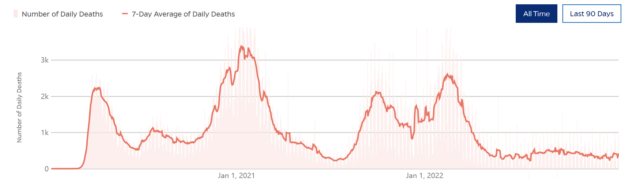
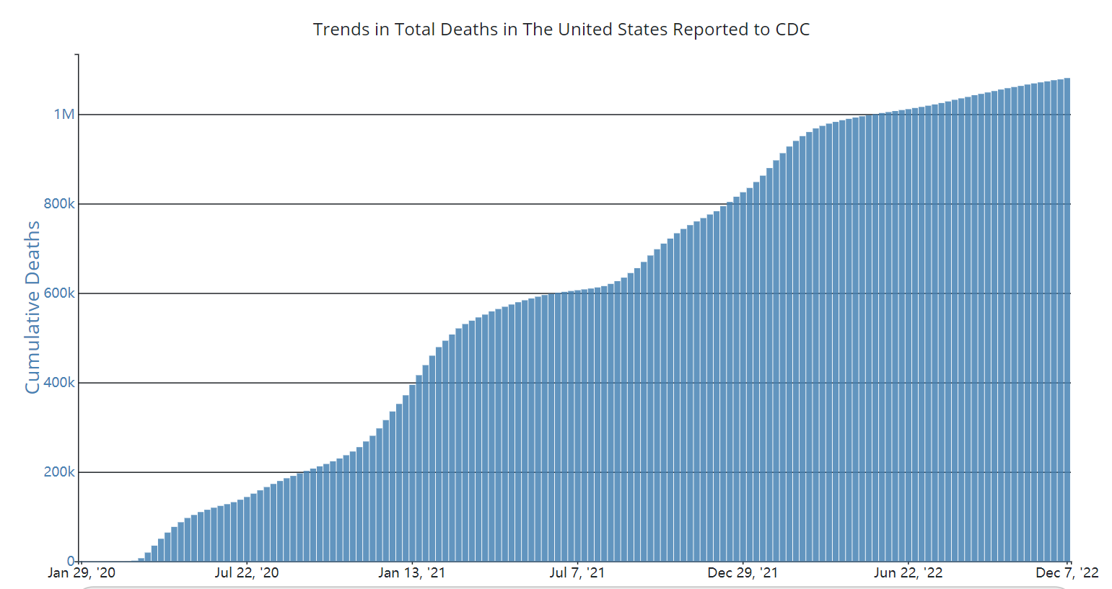
Data Description—Development timeline
Happened around Jan 2020
Twice peak time—Jan 2021 and Jan 2022
Number of daily deaths decreased to below 1k
Reached the best situation ever
Outcomes
Data Description
Model Construction
Recommendation
Q&A

Slide 12
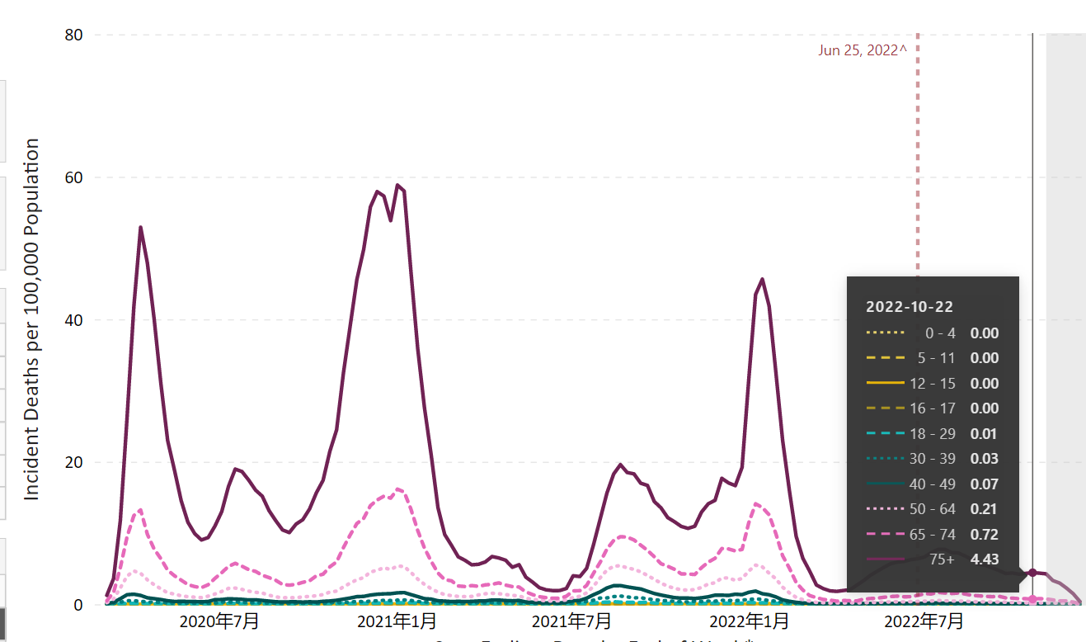
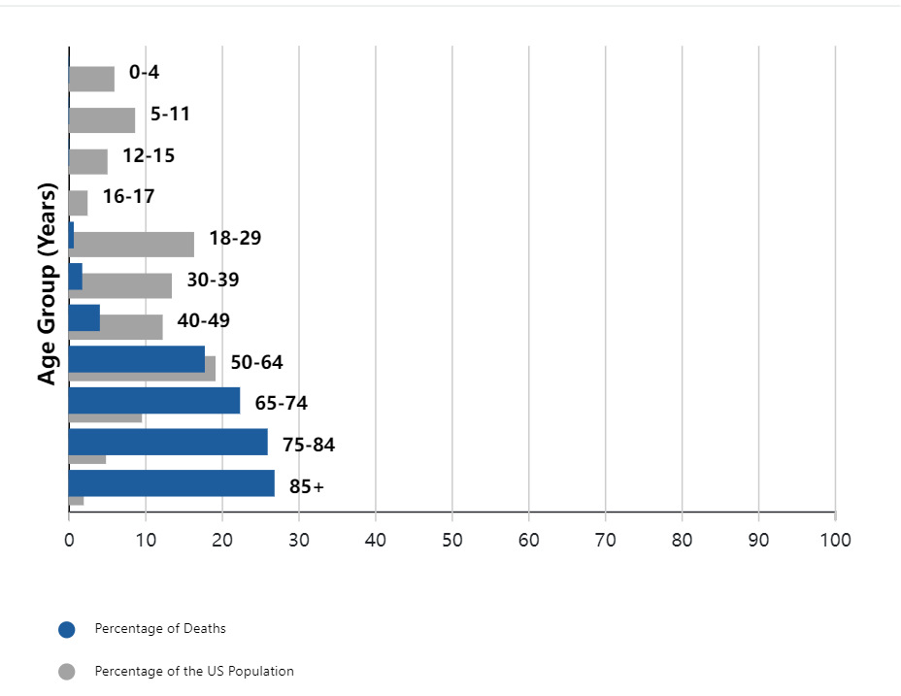
Data Description—Death by AGE
Same development pattern for all ages
The older people are, the higher the death rate
Outcomes
Data Description
Model Construction
Recommendation
Q&A

Slide 13
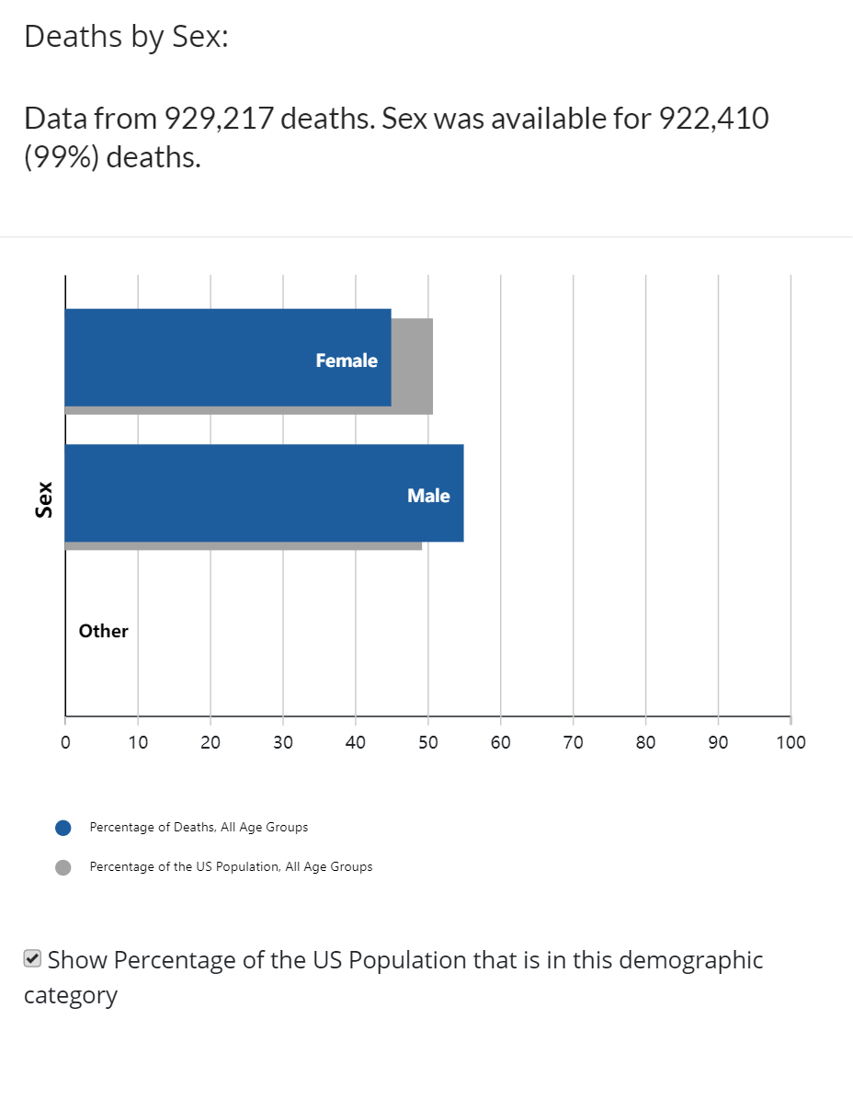
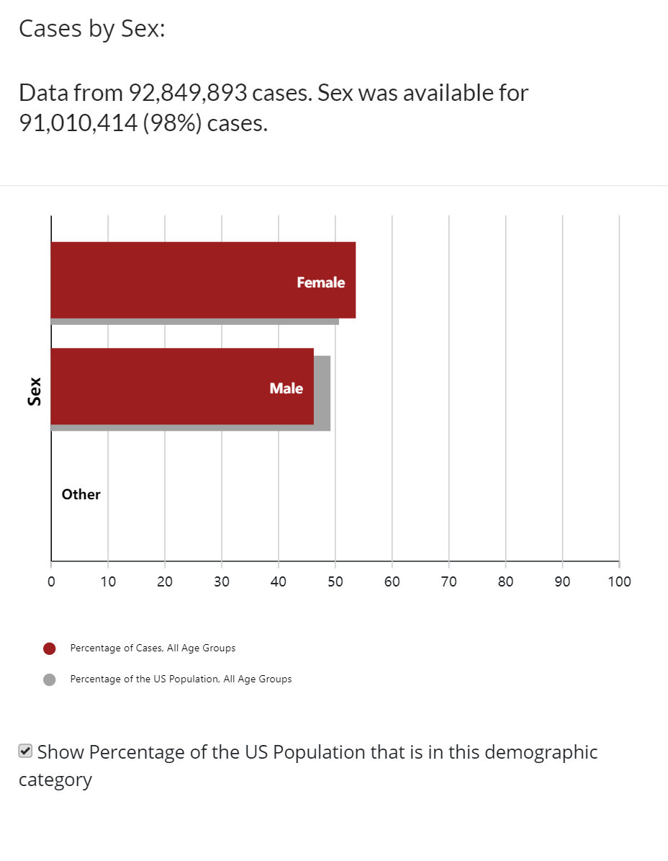
Data Description—Death by GENDER
Deaths by Sex
Cases by Sex
Outcomes
Data Description
Model Construction
Recommendation
Q&A

Slide 14
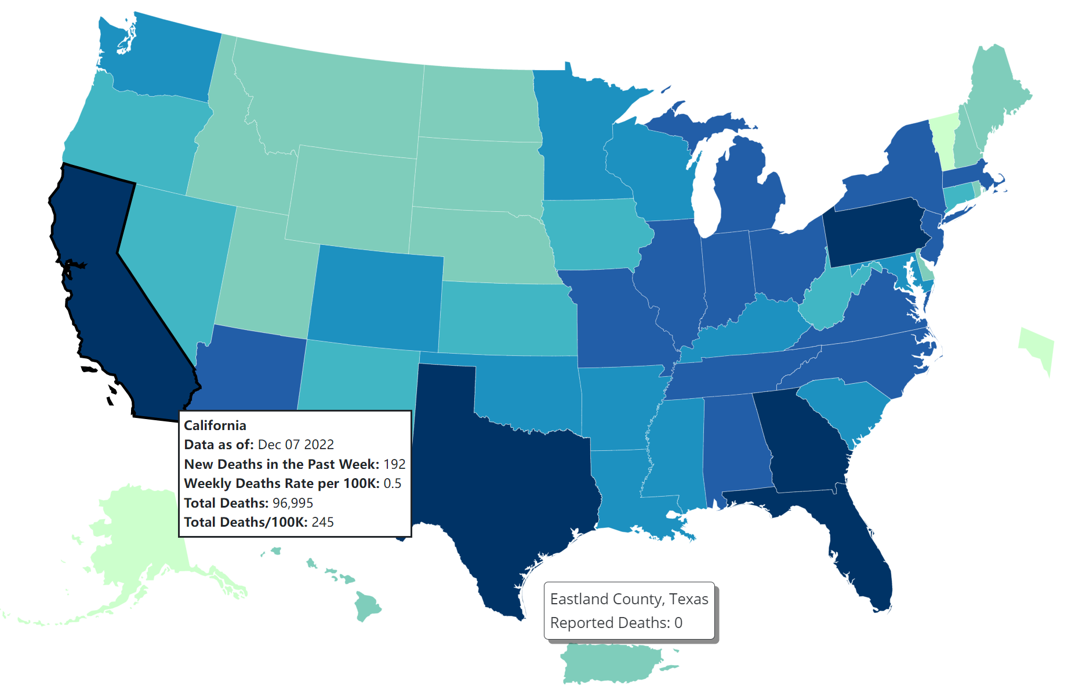
Data Description—Death by REGION
Pennsylvania
California
Georgia
Florida
Texas
Outcomes
Data Description
Model Construction
Recommendation
Q&A

Slide 15
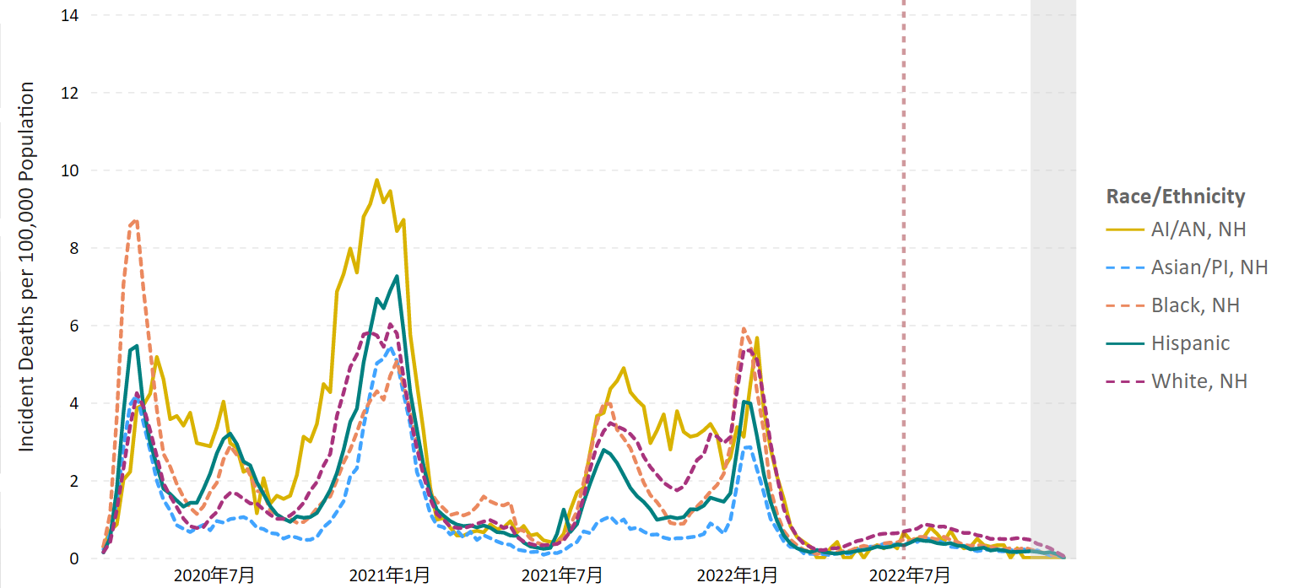
Data Description—Death by RACE
No clear difference
There was one time that American Indians and Alaska Natives had terrible number of death
Asian race have relative better situation
Death of black race from COVID-19 was most in the beginning.
Outcomes
Data Description
Model Construction
Recommendation
Q&A

Slide 16

Models Construction
03

Slide 17
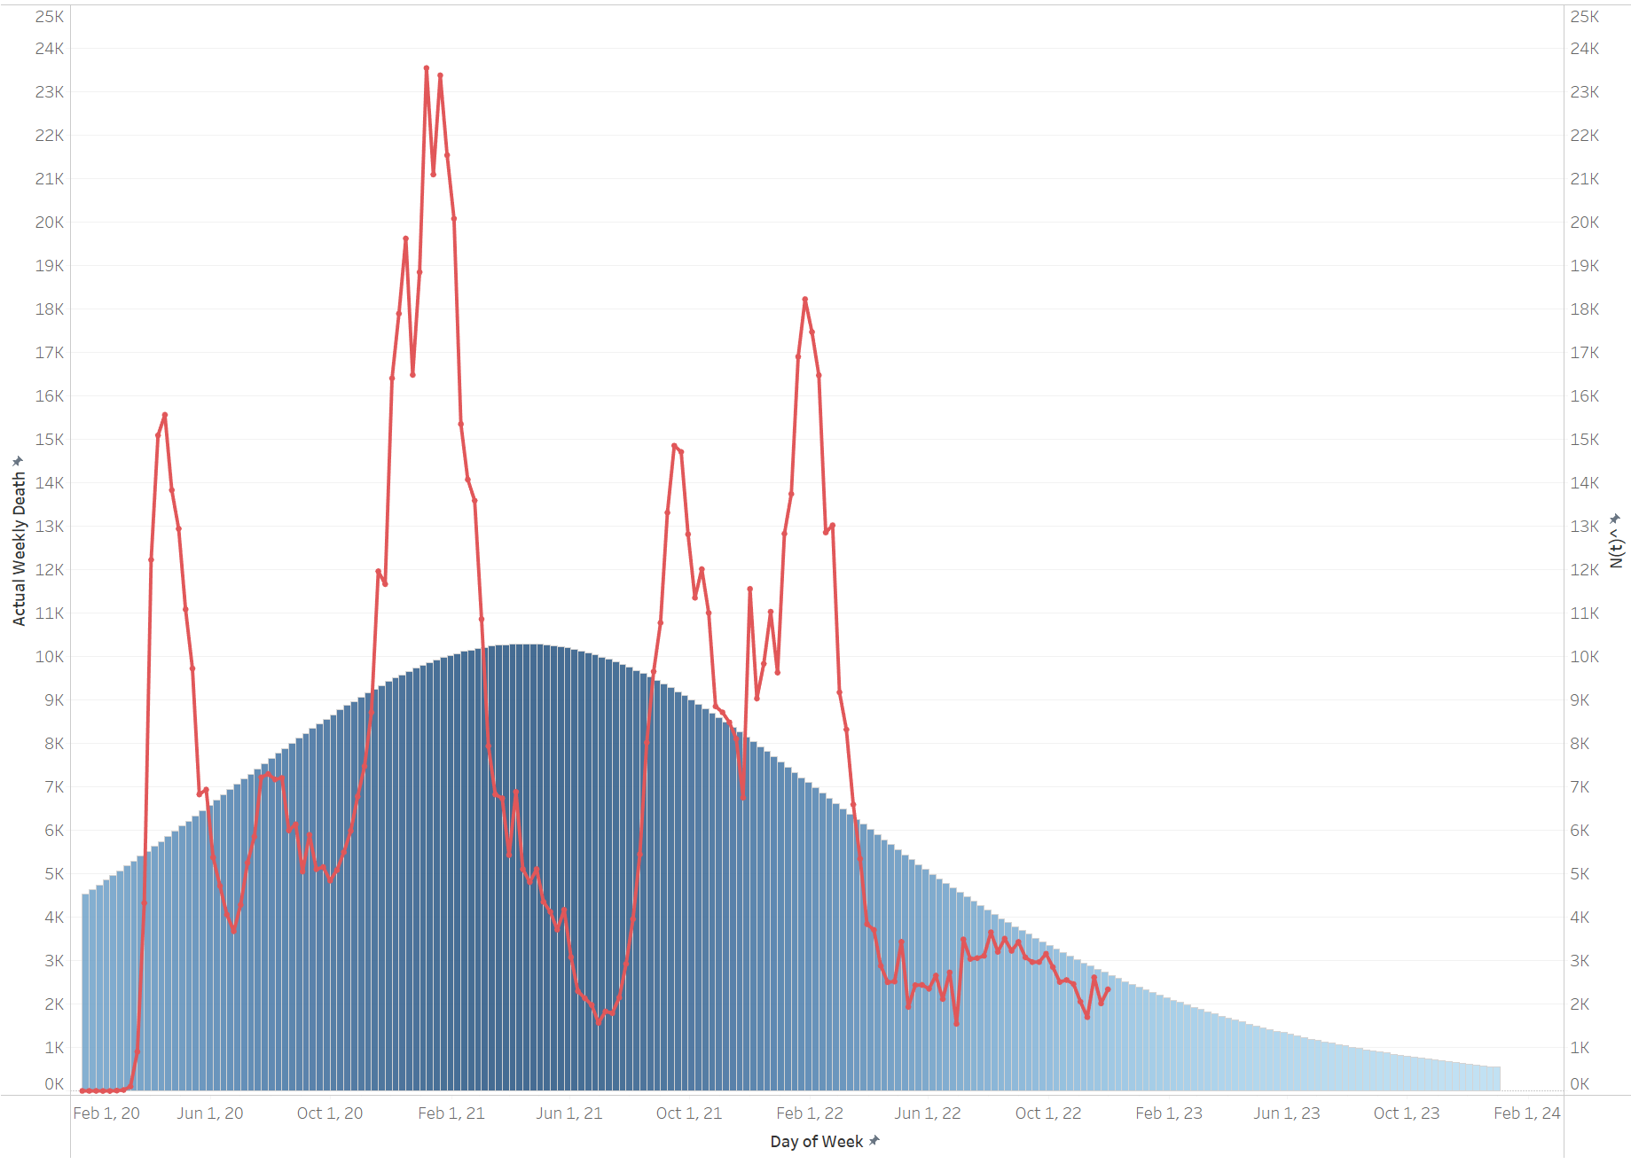
Bass Model Overview
Like a new product adoption model in marketing
The Bass Model approach and fit the model for COVID in a bell shape.
Approximate the p, q, m with the smallest SSE between prediction and actual death in Solver:
p: coefficient of intrinsic susceptibility
q: coefficient of infectable susceptibility
m: susceptible population, the total number of people who will die from COVID
Like a new product adoption with new adopters, maturity and decline stage
Bass model believes we are in a decline stage of death
New adopters
maturity
decline
Outcomes
Data Description
Model Construction
Recommendation
Q&A

Slide 18
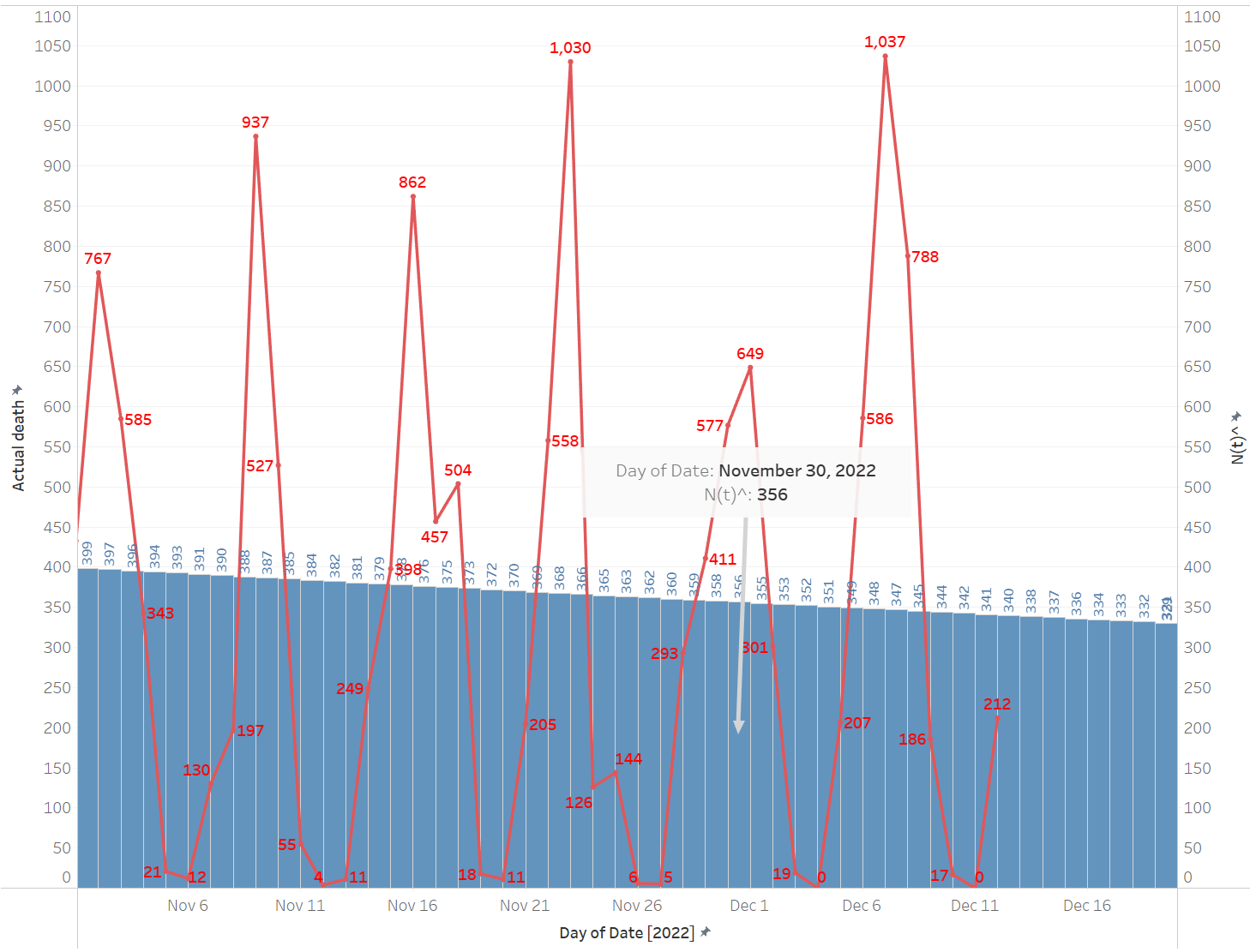
Bass Model - Daily
Predict death daily from Bass Model is not very accurate.
Red Line: Actual Death
The reporting of daily death is fluctuating. Daily prediction is not very accurate. Hospitals may not update records every day.
Blue Bar: Predicted Death on Nov. 30, 2022
356
Average Difference between test and validation
577-356=221
The prediction is more of average of recent days instead of approaching the actual number of that day.
Outcomes
Data Description
Model Construction
Recommendation
Q&A

Slide 19
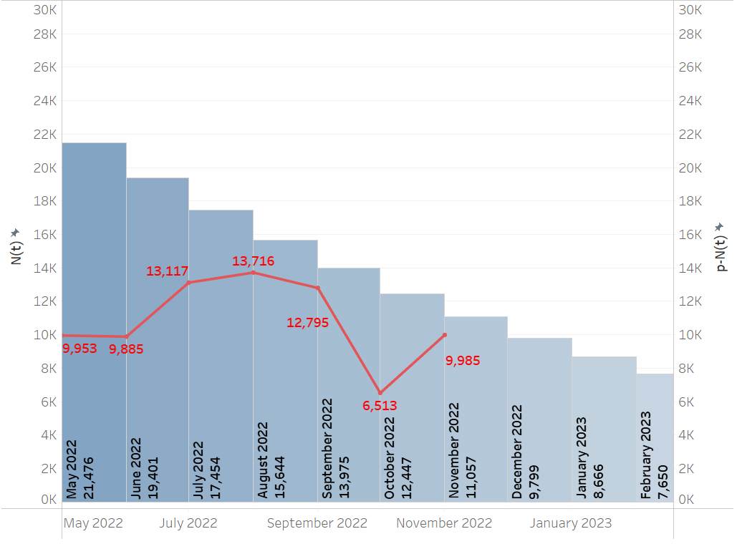
Bass Model - Monthly
The difference between actual and prediction is smaller than daily model
Actual Death in November 2022
9985
Predicted Death in November 2022
11,057
Difference between test and validation
1072
Prediction for next month is the most accurate
Outcomes
Data Description
Model Construction
Recommendation
Q& A

Slide 20
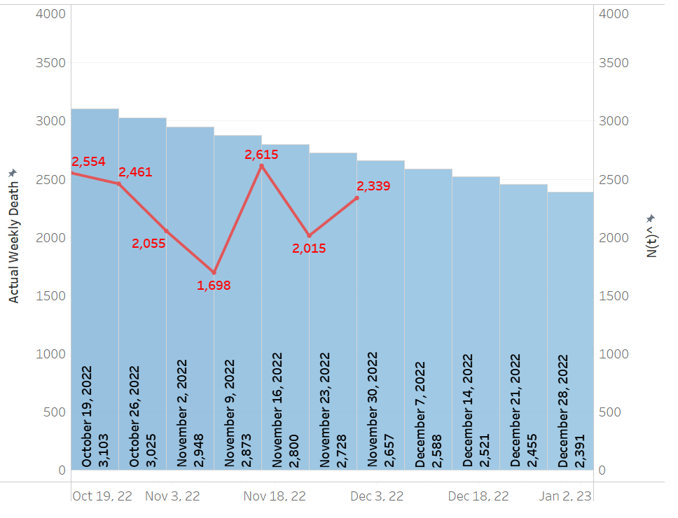
Bass Model - Weekly
The most accurate among US bass models
Red Line: Actual Death
2055; 2615; 2015; 2339
Blue Bar: Predicted Death in those three weeks
2948; 2800; 2728; 2657
Difference between test and validation
645
Having Weekly level in bass model approaching total death in the U.S. is the most accurate
Outcomes
Data Description
Model Construction
Recommendation
Q& A

Slide 21
Bass Model Prediction
All bass models predict that in 2025 COVID-19 death would fade out
~60,000 deaths -> $60m-70m extra claims
 | 12/17/2022 | 12/17/2022-12/23/2022 | December 2022 | 2023 | 2024 | 2025
Daily Bass Model Prediction | 333 | 2305 | 10373 | 59074 | 12129 | 2374
Weekly Bass Model Prediction |  | 2455 | 9955 | 64740 | 14137 | 2962
Monthly Bass Model Prediction |  |  | 9799 | 56526 | 11402 | 2202
Outcomes
Data Description
Model Construction
Recommendation
Q&A

Slide 22
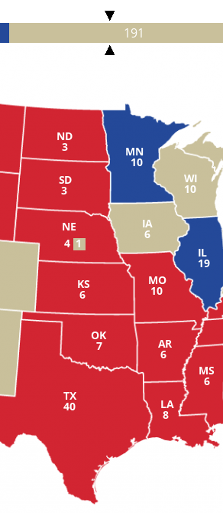
Predict Death in State Degree
Run Bass model in every state
Make predictions through daily, weekly, monthly levels
Utilize python to find the optimal solution of parameters(p, q, m) for each state
Sum up all predicted data from all states
Compare the predicted outcomes and the real value
Outcomes
Data Description
Model Construction
Recommendation
Q&A

Slide 23
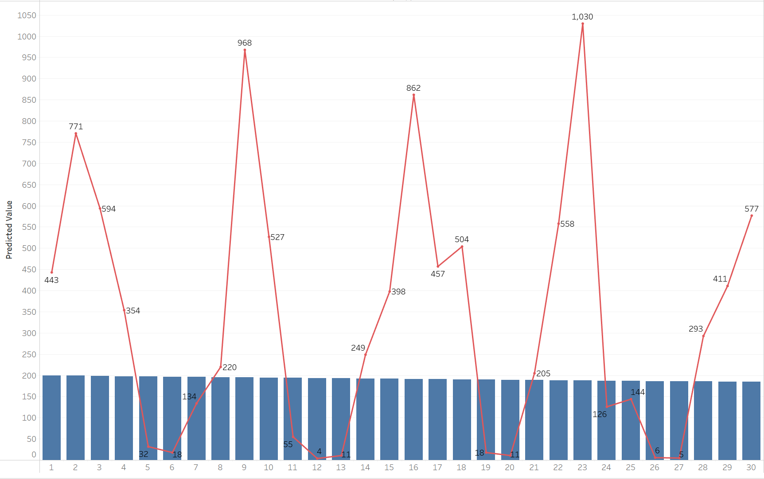
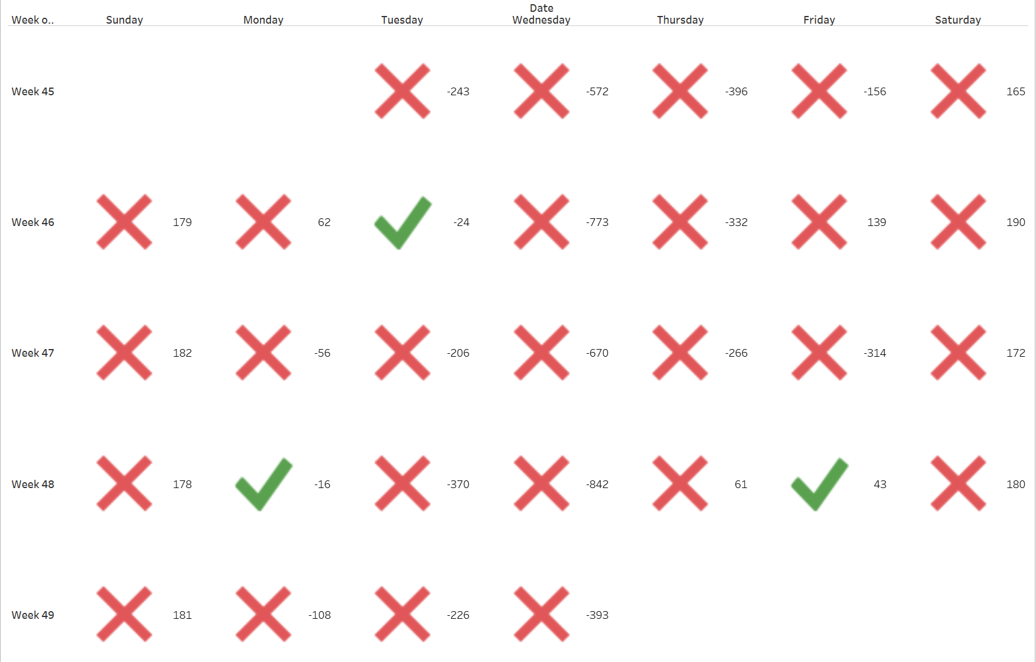
Bass Model on State degree-Daily
In the validation month of November, differences between predicted and actual deaths are big (>50)
Difference between predicted value and real value is big
The predicted values have a smooth line without big fluctuations
Perform poorly compared to the U.S. degree
Outcomes
Data Description
Model Construction
Recommendation
Q&A

Slide 24
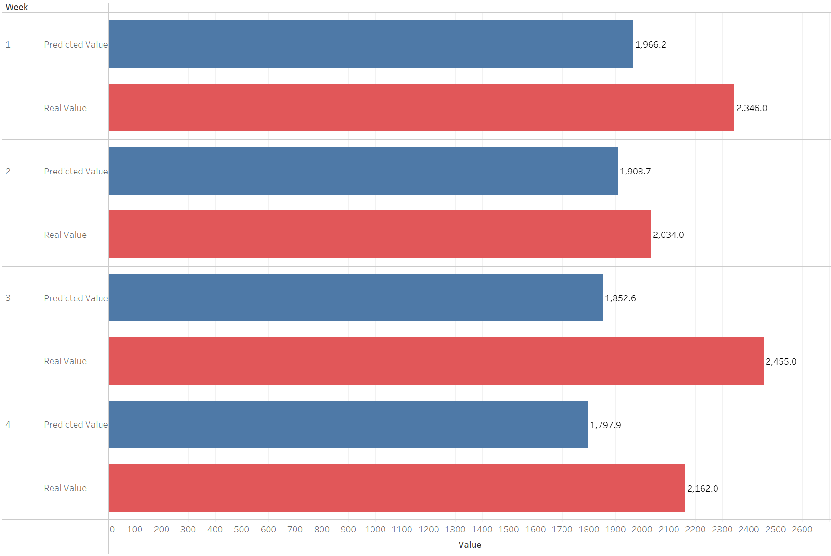
Bass Model on State degree-Weekly
Predicted death in November 2022--
1966, 1908, 1852, 1797
Quite similar between predicted values and real values
Performs better than the daily model
A decreasing tendency for predicted model while real value is fluctuating
Outcomes
Data Description
Model Construction
Recommendation
Q&A

Slide 25
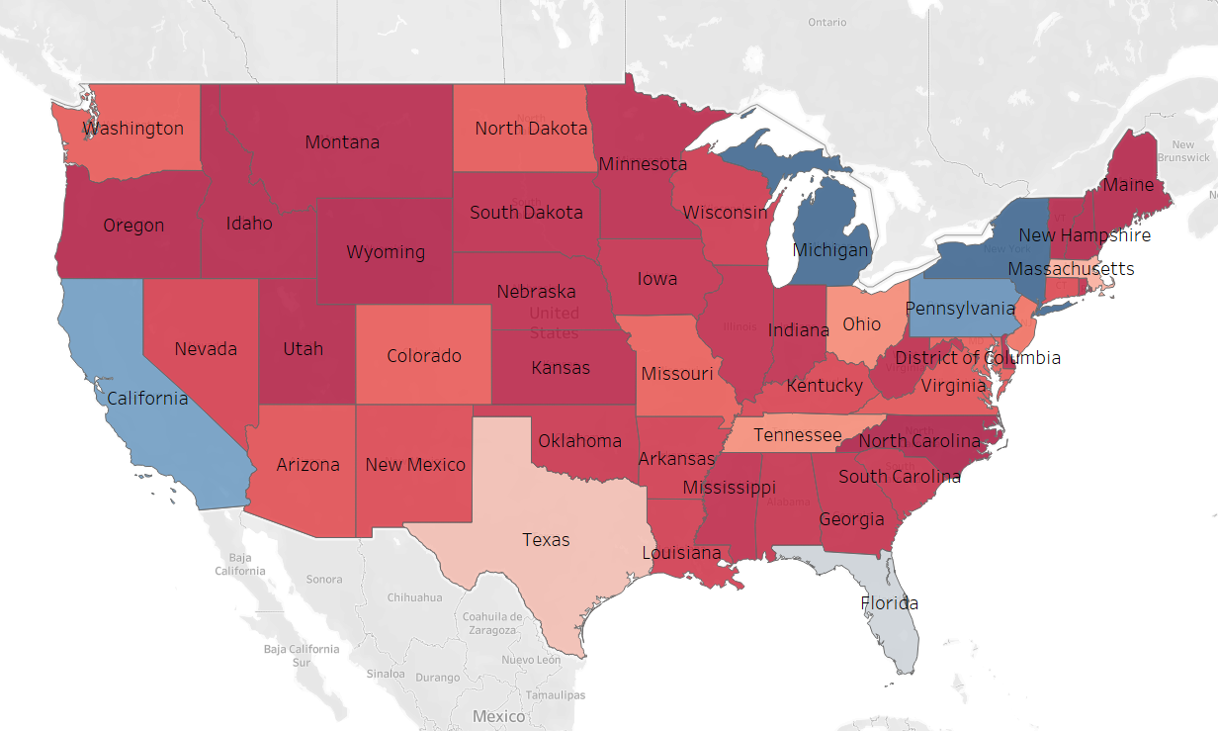
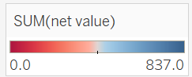
Bass Model on State degree-Monthly
Predicted Death in November 2022
8916
Difference between predicted death and real death:
1068
No fit area: not suitable for Bass Model
California, Michigan, New York
These states have a huge difference between predicted and actual death when running a bass model
Red areas have better performance in approaching bass model
findings
Data Description
Model Construction
Recommendation
Q&A

Slide 26
Compare All State Degree Bass Models
 | 2022/11/30 | Real Death | 2022/11/21-2022/11/27 | Real death | 2022/11 | Real death
Daily Bass model | 184 | 577 | 1312 | 2074 | 5755 | 9985
Weekly Bass model |  |  | 1798 |  | 7525
Monthly Bass model |  |  |  |  | 8926
Outcomes
Data Description
Model Construction
Recommendation
Q&A

Slide 27
SIRD Model Intro
The Susceptible-Infectious-Recovered-Deceased model
S = The number of susceptible individuals (S0: number of initial susceptible individuals)
I = The number of infectious individuals (I0: the number of individuals who get infected)
Beta = Contact Rate
Gamma = Recovery Rate
d = Death Rate
R
γ
β
I
S
d
D
Outcomes
Data Description
Model Construction
Recommendation
Q&A

Slide 28
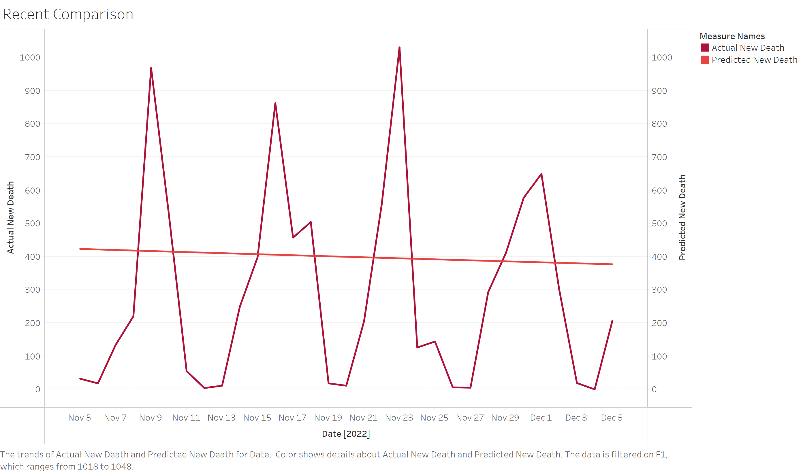
SIRD Model
Comparisons and Predictions
 | 2022/11/30 | Real Death | 2022/11/21-2022/11/27 | Real death | 2022/11 | Real death
SIRD | 384 | 577 | 2572 | 2074 | 12191 | 9985
Daily Predictions for Dec 16, 2022
360
Monthly Prediction for Dec 2022
11189
Yearly Prediction for 2023
63827
Outcomes
Data Description
Model Construction
Recommendation
Q&A

Slide 29
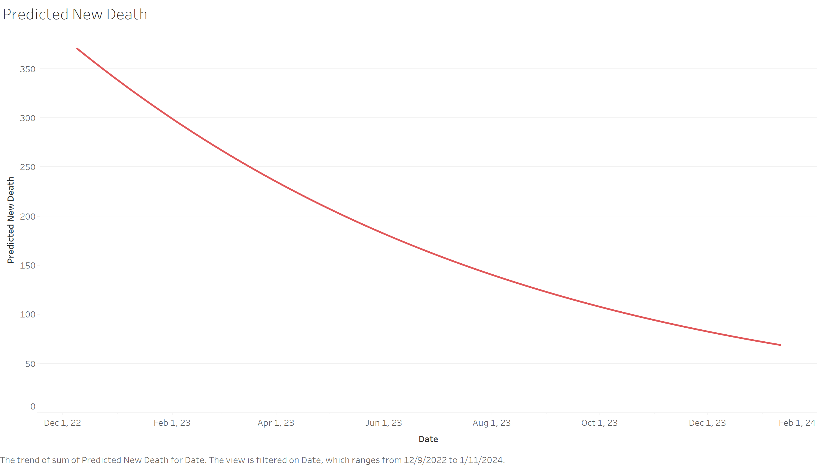
SIRD Model
Predicted Future Trends
Model Trends for Future Deaths
Decreasing Trend
Parameters for S0 + I0
18.3 M:
Total number of people who will be influenced by COVID-19
Outcomes
Data Description
Model Construction
Recommendation
Q&A

Slide 30
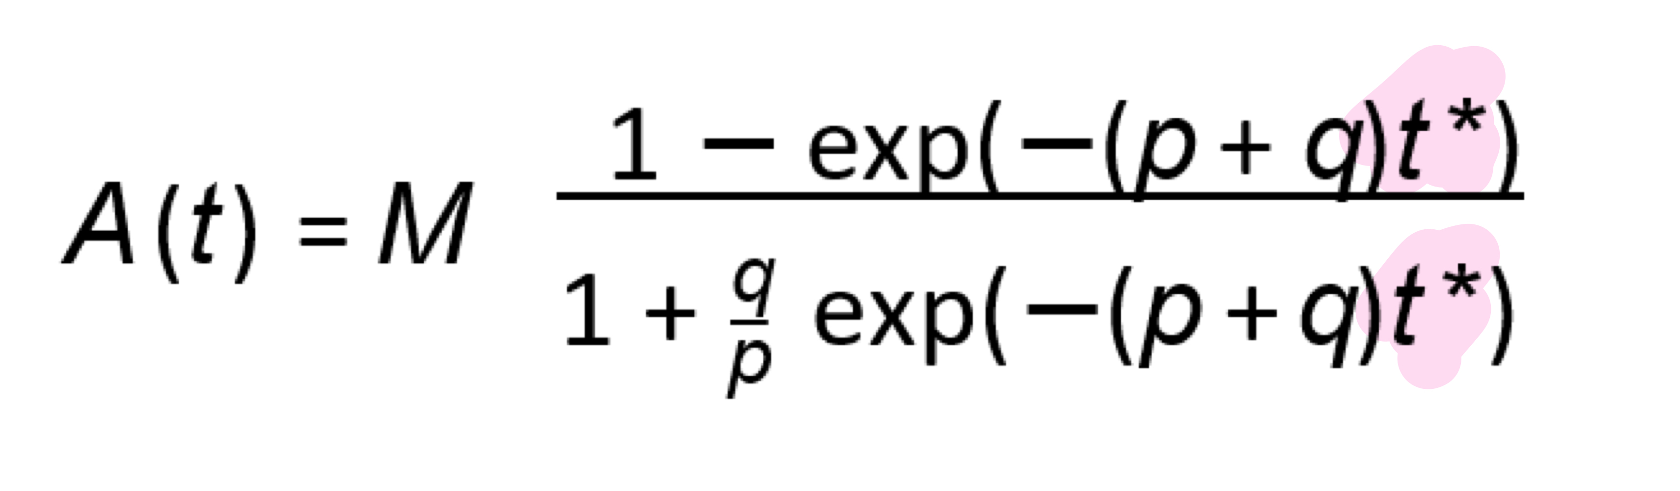
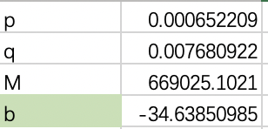
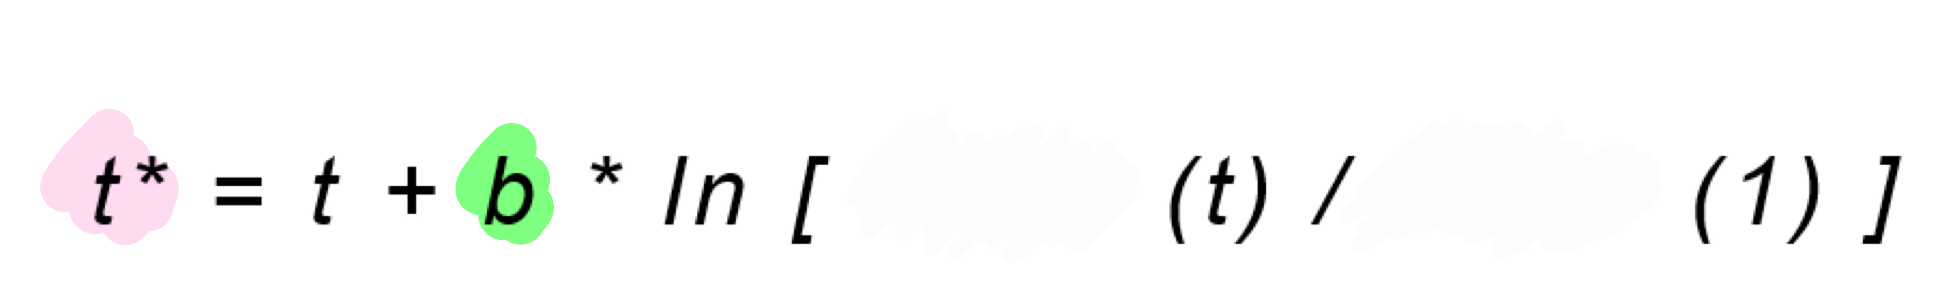
Generalized Bass Model (GBM)
t
t*
Allow seeing the influence of Vaccines
Vaccine
Vaccine
-
- * +
b is negative!
t*< t
Outcomes
Data Description
Model Construction
Recommendation
Q&A
Notes:
In order to further explore the factors that will influence the mortality rate. We utilized generalized bass model instead of the continuous bass model. GBM is the extension of the bass model, and this extension handles variable—vaccines which allow us to see the influence of vaccines on death. We can further examine the new deaths to be influenced not only by infections but also by whether people taking the vaccine or not.There is a big difference compared to bass model which is the t star, t star equals to original t plus a vaccine factor. After we train the data and come up with best parameters, we found that b is negative. While b is negative, the whole vaccine factor becomes negative which makes t star is smaller than t.

Slide 31
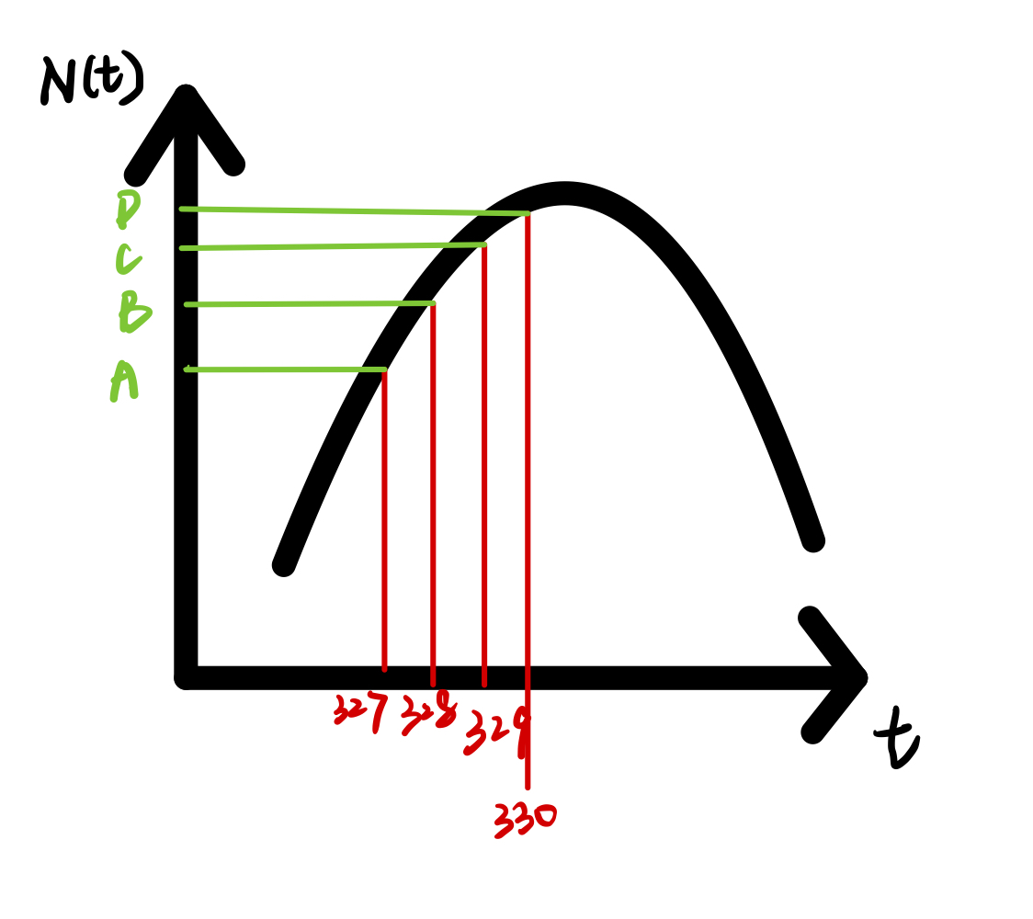
Generalized Bass Model (GBM)
Vaccines effectively slower the speed of new death.
t
t*
B
328
>
327.40
A
C
329
327.21
A
D
330
326.35
A
Outcomes
Data Description
Model Construction
Recommendation
Q&A
Notes:
Based on the result that t* is smaller than t, we can conclude that vaccines effectively slower the speed of new death. According to the table and chart, when point B C D are much higher than A, thus when in the same period, the number of new death with the vaccine is way smaller than without the vaccine. Again,administration of vaccine is effective.

Slide 32
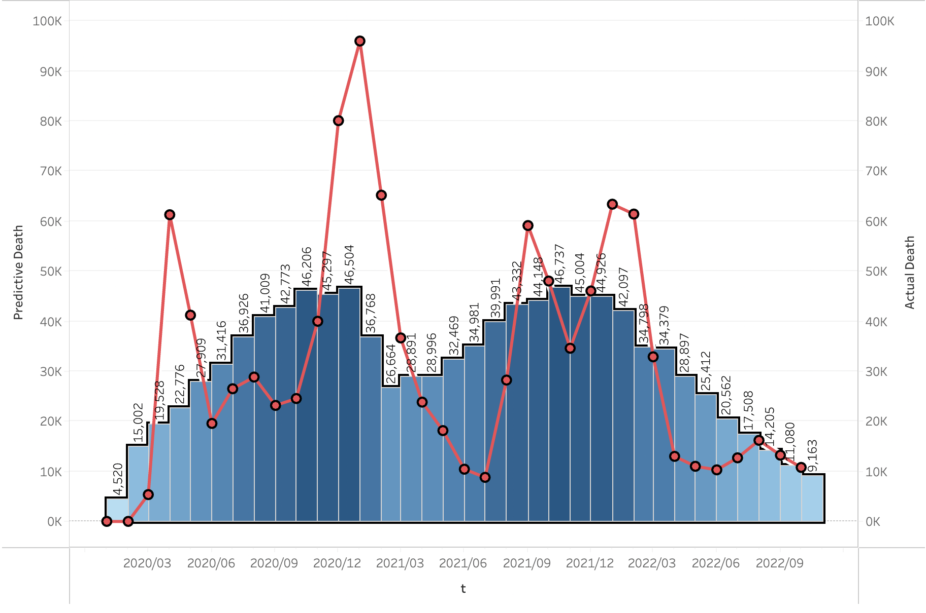
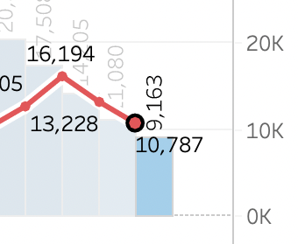
Generalized Bass Model (GBM)
Prediction accuracy evaluation
Predictive total death: October 1st-October 31st
9163
Blue Bar chart
Actual total death:
10787 Red Line chart
Oct 2022
Outcomes
Data Description
Model Construction
Recommendation
Q& A
Notes:
According to the evaluation visualization, the blue bar chart represent the predictive death, and the red line chart represent the actual total death. After we confirm the effectiveness of the administration of the vaccine, we use the training data to predict the total death in October which is around 9163, and the actual death for October is 10,787. The is a difference around 1600.

Slide 33
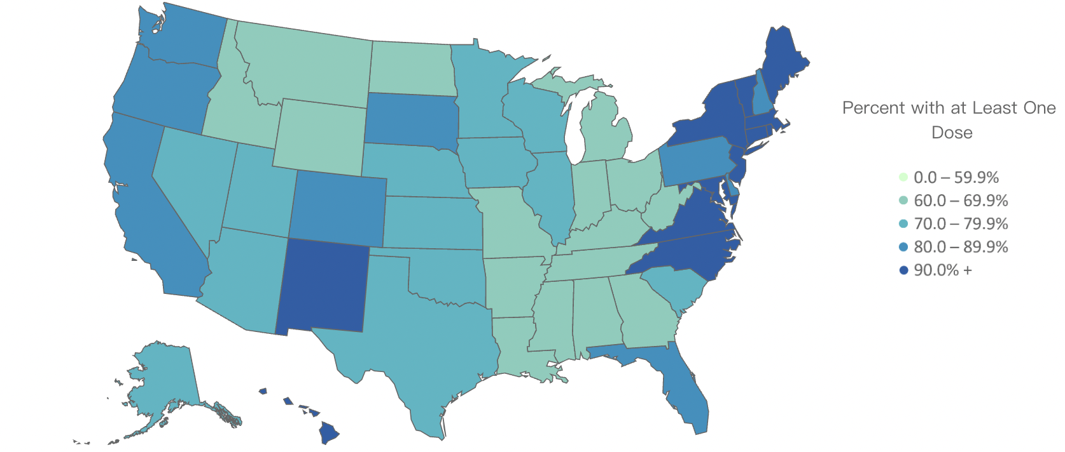
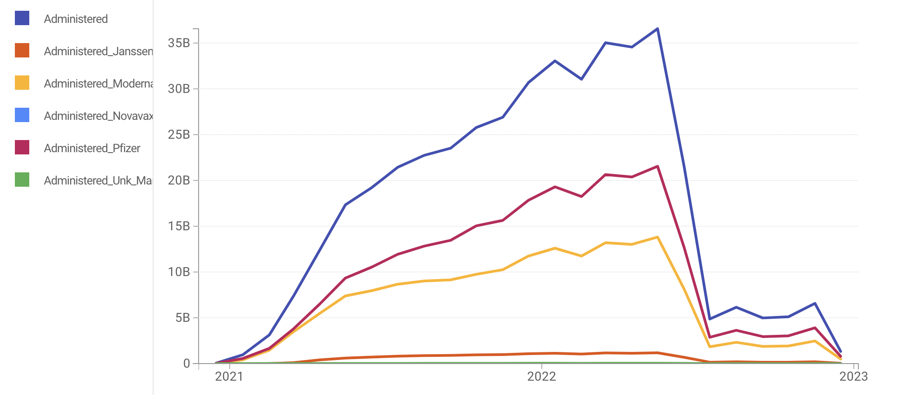
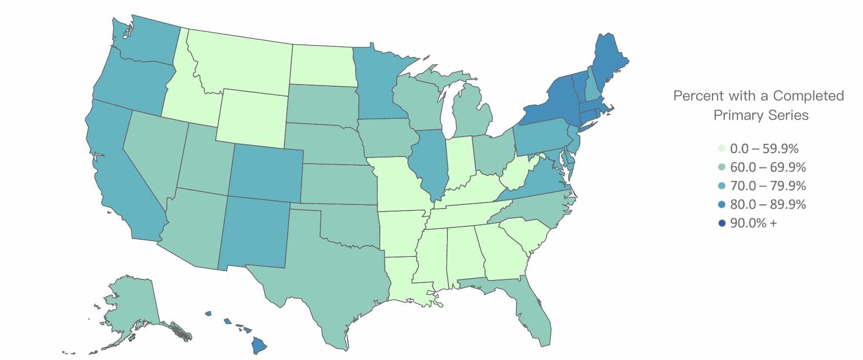
Generalized Bass Model (GBM)
t
t*
Overview of Vaccines
Focus more on both the north and southeast areas since these areas have lower percentage of vaccine administered.
Outcomes
Data Description
Model Construction
Recommendation
Q&A
Notes:
Let’s take a closer look at the vaccine, this line chart is showing the number of people who take the different vaccines, and the majority of people choose to take Pfizer. Besides that, there are maps showing the percentage with at least one dose and the percentage with completed doses, it is obvious that both north and southeast areas have lower percentages

Slide 34

Recommendation
04

Slide 35
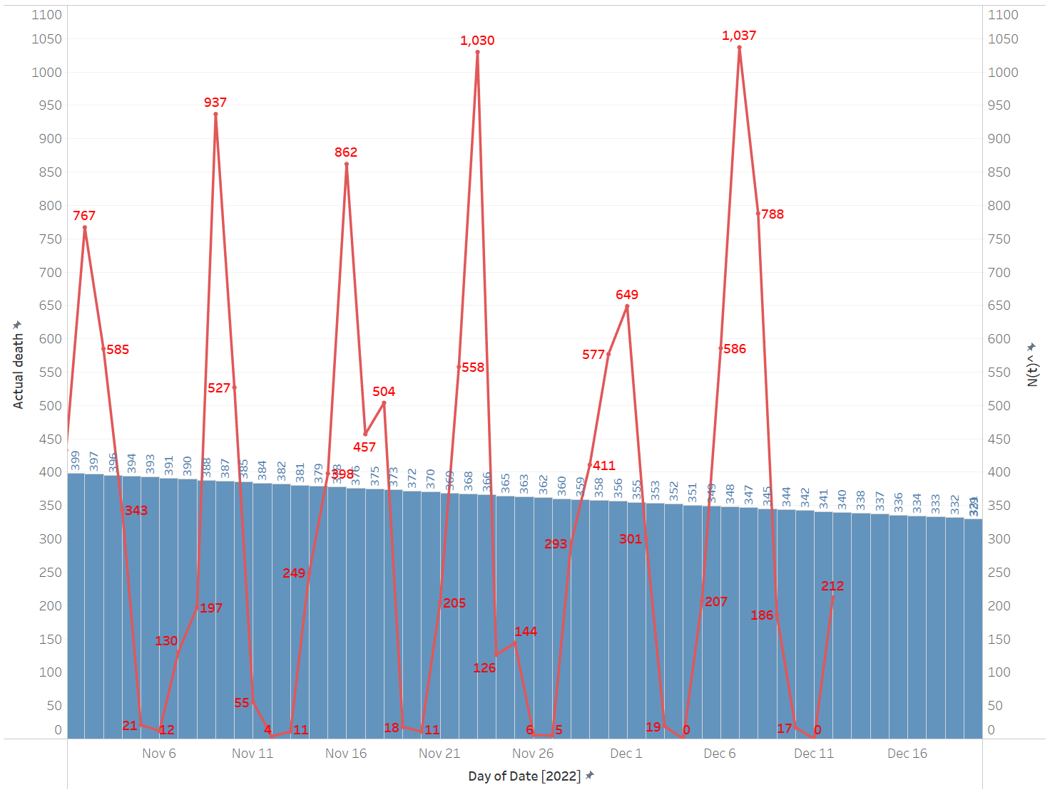
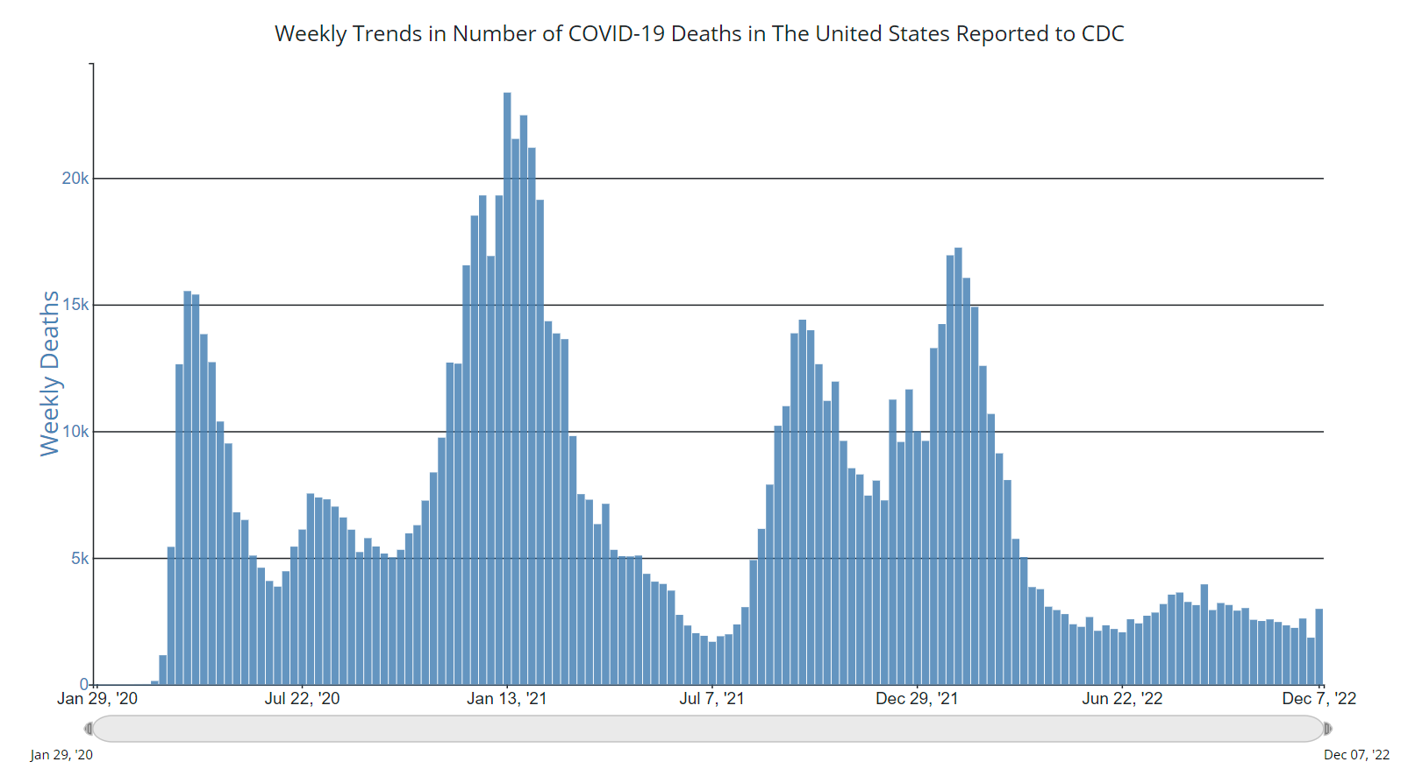
1
Focus on monthly/weekly forecast
t
The data of daily deaths comes from JHU dashboard. The report of COVID deaths is more weekly based and fluctuating.
CDC only reports weekly deaths/cases on the official website now.
https://covid.cdc.gov/covid-data-tracker/#trends_weeklydeaths_select_00
Outcomes
Data Description
Model Construction
Recommendation
Q&A

Slide 36
2
Use SIRD/state level bass model as a prediction model
t
Models | Next day (11.30) | 7-days (11.21-11.27) | next month 11
US Level- Bass model | 356 | 2728 | 11057
State Level- Bass model | 184 | 1312 daily 1798 weekly | 5755 daily 7525 weekly 8926 monthly
SIRD | 384 | 2572 | 12191
Actual | 577 | 2074 | 9985
Next day — SIRD
7-days — State Level Bass model (Weekly basis)
Next month — State Level Bass model (Monthly basis)
Outcomes
Data Description
Model Construction
Recommendation
Q&A

Slide 37
3
Focus on separating into smaller areas with bass prediction will yield a more accurate prediction (US level—State level—City level)
t
Models | Next day (11.30) | 7-days (11.21-11.27) | next month 11
US Level- Bass model | 356 | 2728 | 11057
State Level- Bass model | 184 | 1312 daily 1798 weekly | 5755 daily 7525 weekly 8926 monthly
SIRD | 384 | 2572 | 12191
Actual | 577 | 2074 | 9985
Overall, bass model in a state level yield a more accurate prediction.
We could focus on city level in the future
Running model in a regional level and then aggregate data together in a US level would be better.
Outcomes
Data Description
Model Construction
Recommendation
Q&A

Slide 38
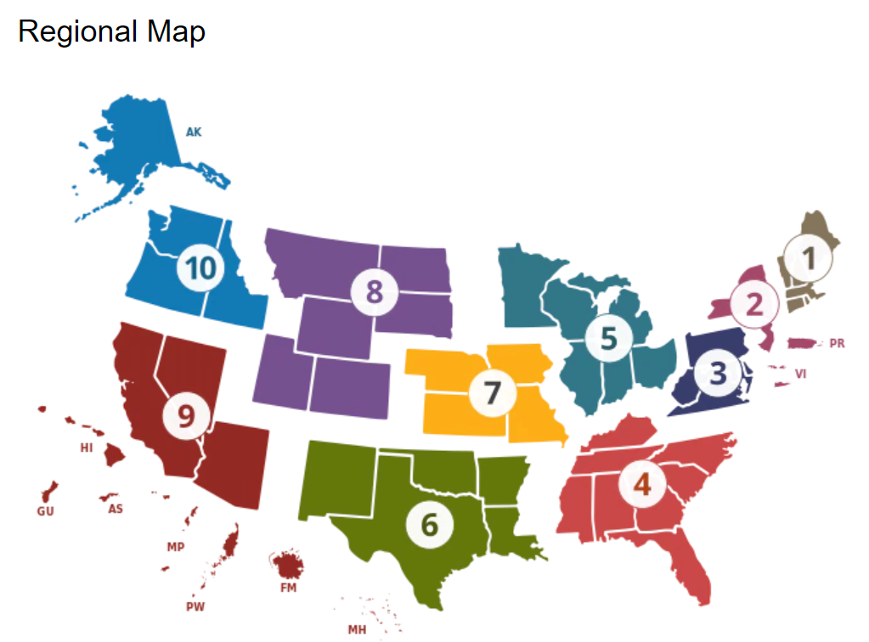
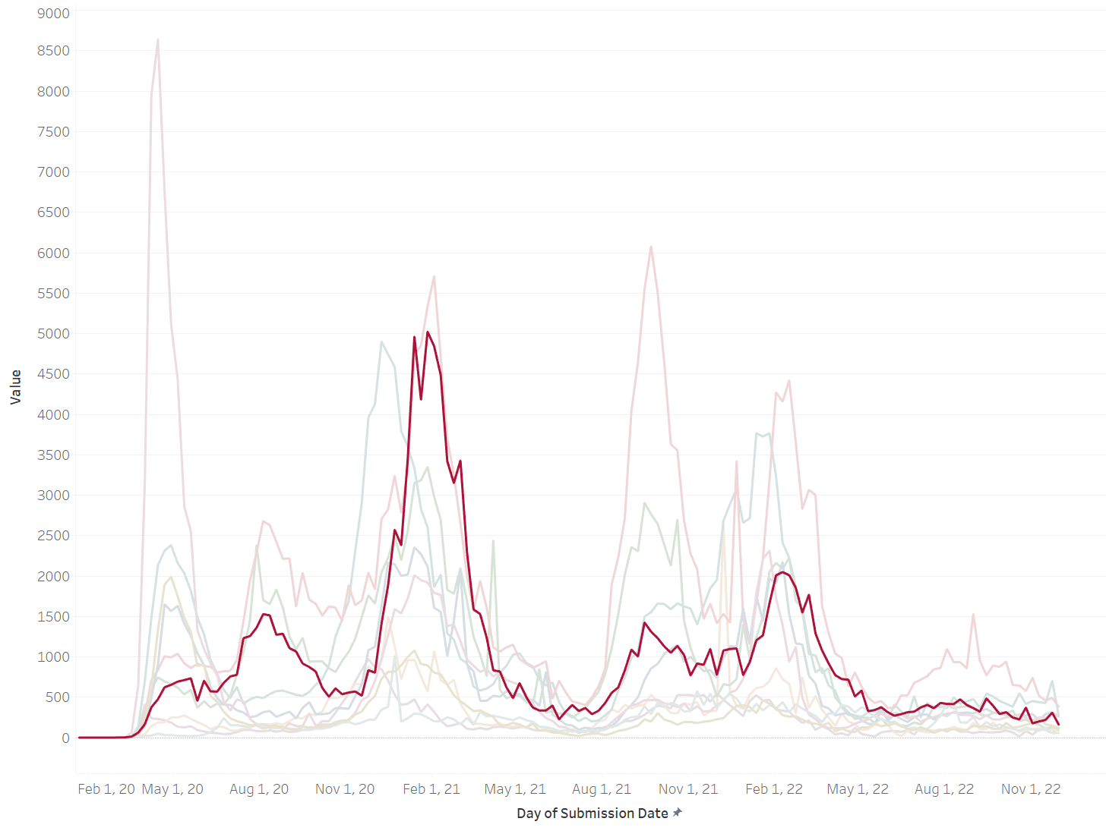
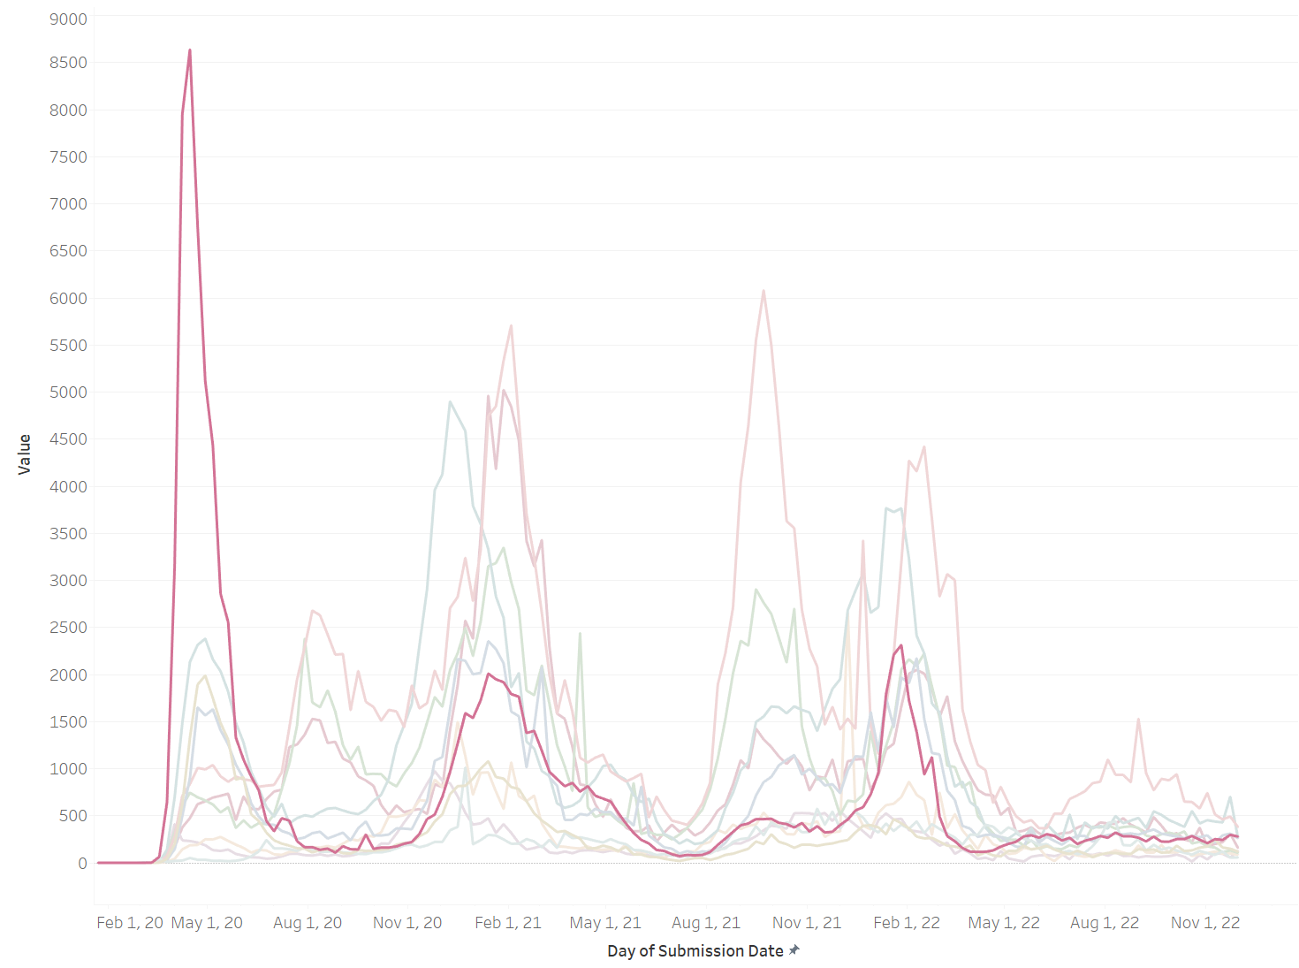
4
Promote reinsurance in certain areas like Seattle and Florida
t
California
New York
First
Delta
Outcomes
Data Description
Model Construction
Recommendation
Q&A

Slide 39
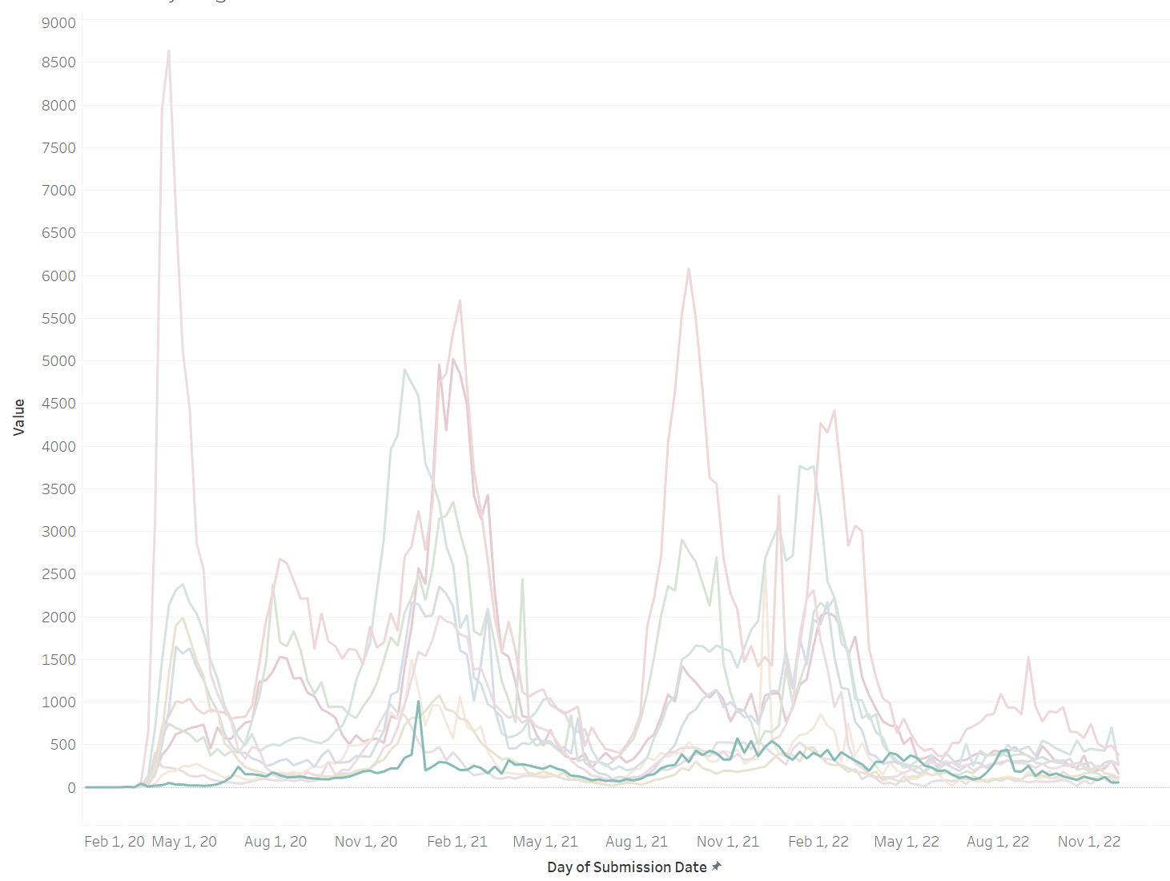
4
Promote reinsurance in certain areas like Seattle and Florida
t
Regions that have suffered deaths from previous wave of COVID variant would have fewer deaths in the next wave
Seattle area may encounter a great loss of deaths if a new strong variant is introduced because it has never a huge wave of COVID breakout.
Outcomes
Data Description
Model Construction
Recommendation
Q&A

Slide 40
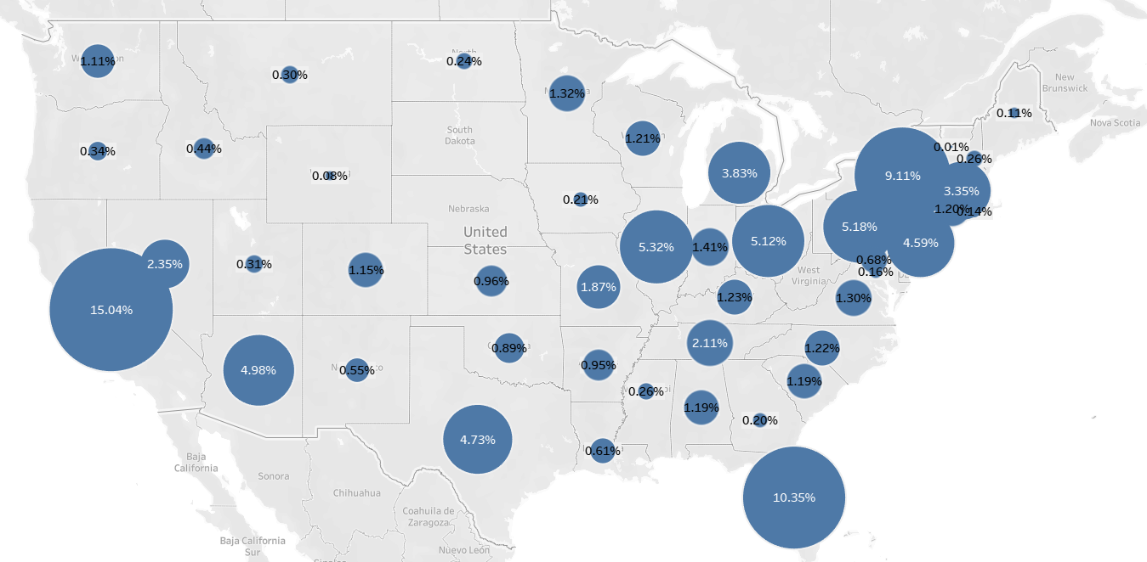
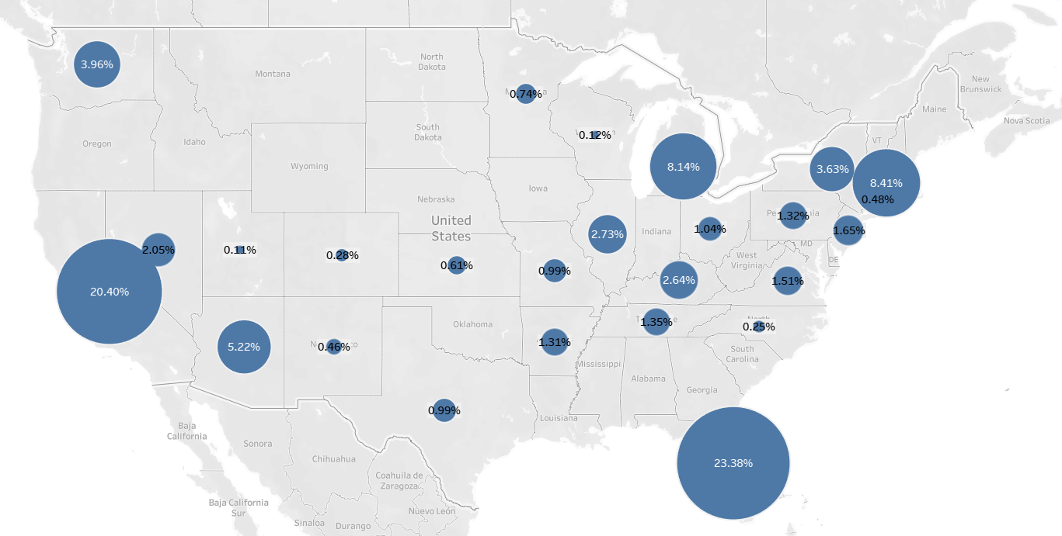
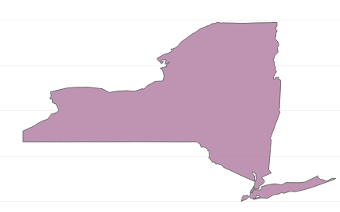
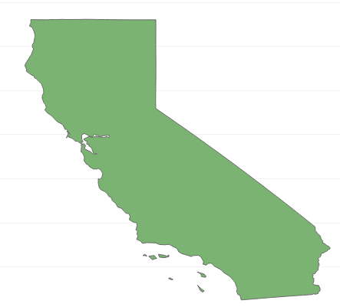
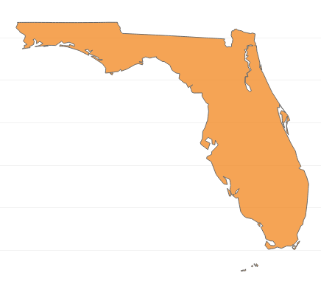
4
Promote reinsurance in certain areas like Seattle and Florida
t
Before June 2022
Last 6 Month
New York area and California have a high percentage of death contributed before.
Florida has increasing percent of death in the last 6 month which may be due to a higher percentage of people over 65
Outcomes
Data Description
Model Construction
Recommendation
Q&A

Slide 41
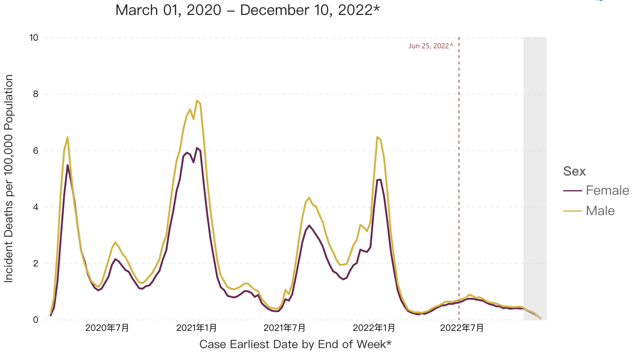
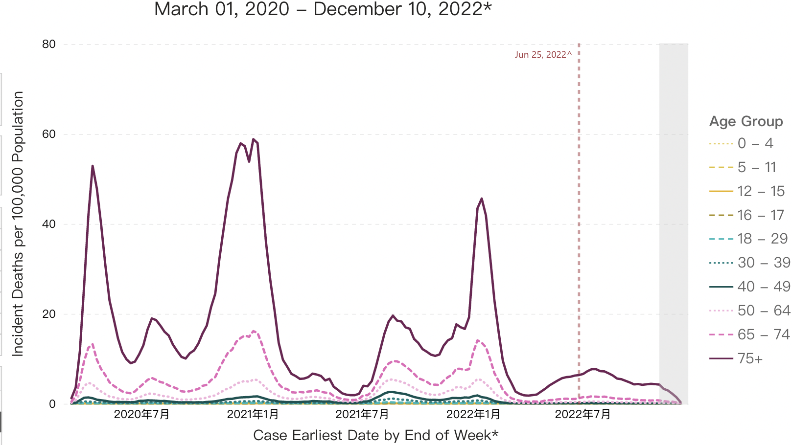
5
Focus on the group of people who is male/75+/FL or CA
t
It is obvious that compared to females, males have a higher mortality rate due to Covid-19.
Among different age groups, people aged 75+ are the most vulnerable group.
Both FL and CA are experiencing a high percentage of the death rate.
Outcomes
Data Description
Model Construction
Recommendation
Q&A
Notes:
For the recommendation 5, we came up with a target customer image, we should focus on male who is over 75 years old and live in FL or CA.
For gender, compared to females, males have a higher mortality rate. According to different age groups, people who are over 75 years old are the most vulnerable group. And both fl and CA are experiencing a high percentage of death rate compared to other states.

Slide 42
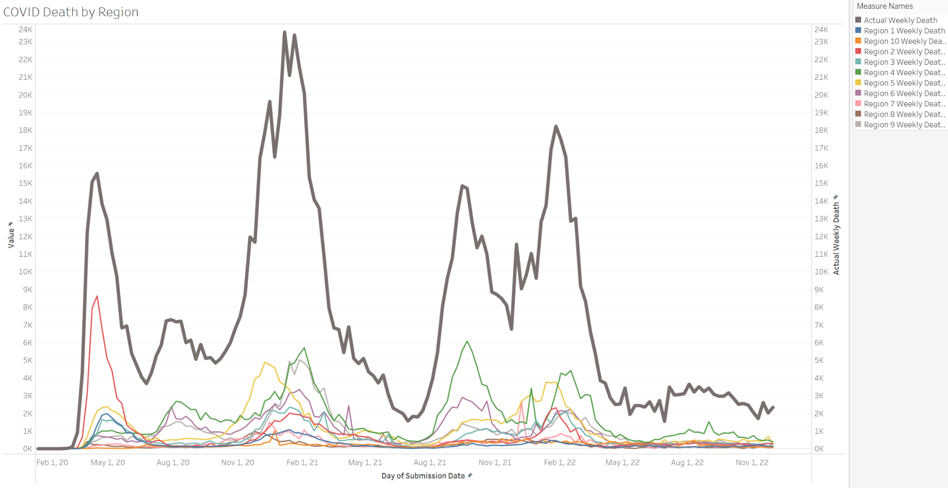
6
Pay great attention to the new variant of covid virus entrance
t
As soon as a new variant of COVID-19 virus enters U.S., an outbreak follows.
Delta
The first detected case in the U.S. was in March 2021
The first detected case in the U.S. was in November 2021
Omicron
Outcomes
Data Description
Model Construction
Recommendation
Q&A

Slide 43
7
Targeting the north and southeast areas for business. (vaccine)
t
Since the number of deaths decreases with the vaccine effects, the company should target the north and southeast areas that have a lower percentage in both "completed primary series" and "with at least one dose”.
Outcomes
Data Description
Model Construction
Recommendation
Q&A

Slide 44
8
Focus on seasonal patterns (winter).
t
Winter Period:
Dec - Feb
Around peak time
Summer Period:
May - Aug
Slowing death rates
Outcomes
Data Description
Model Construction
Recommendation
Q&A

Slide 45
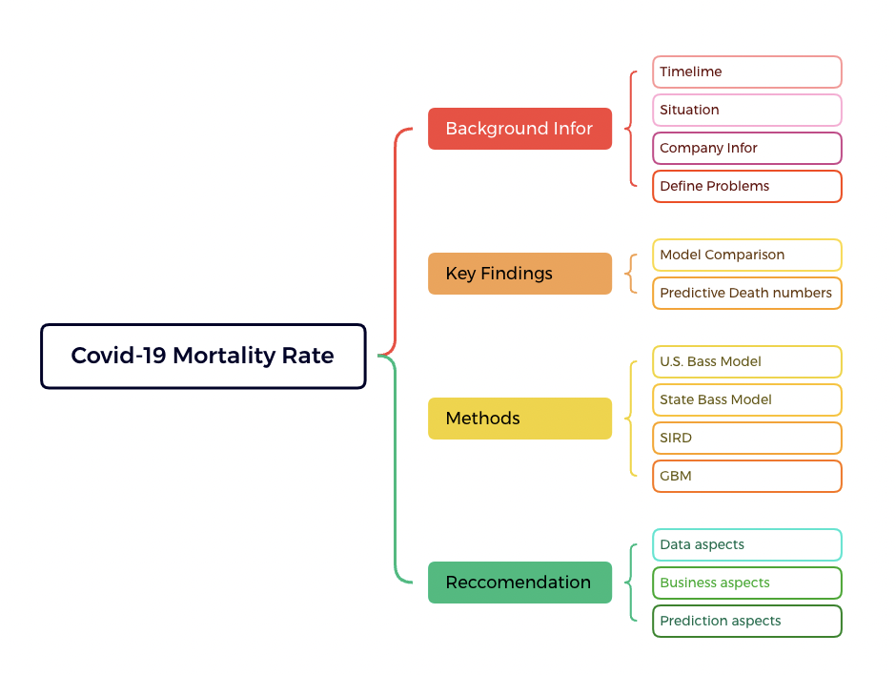


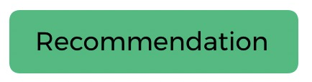
Q&A
Outcomes
Data Description
Model Construction
Recommendation
Q&A

Slide 46
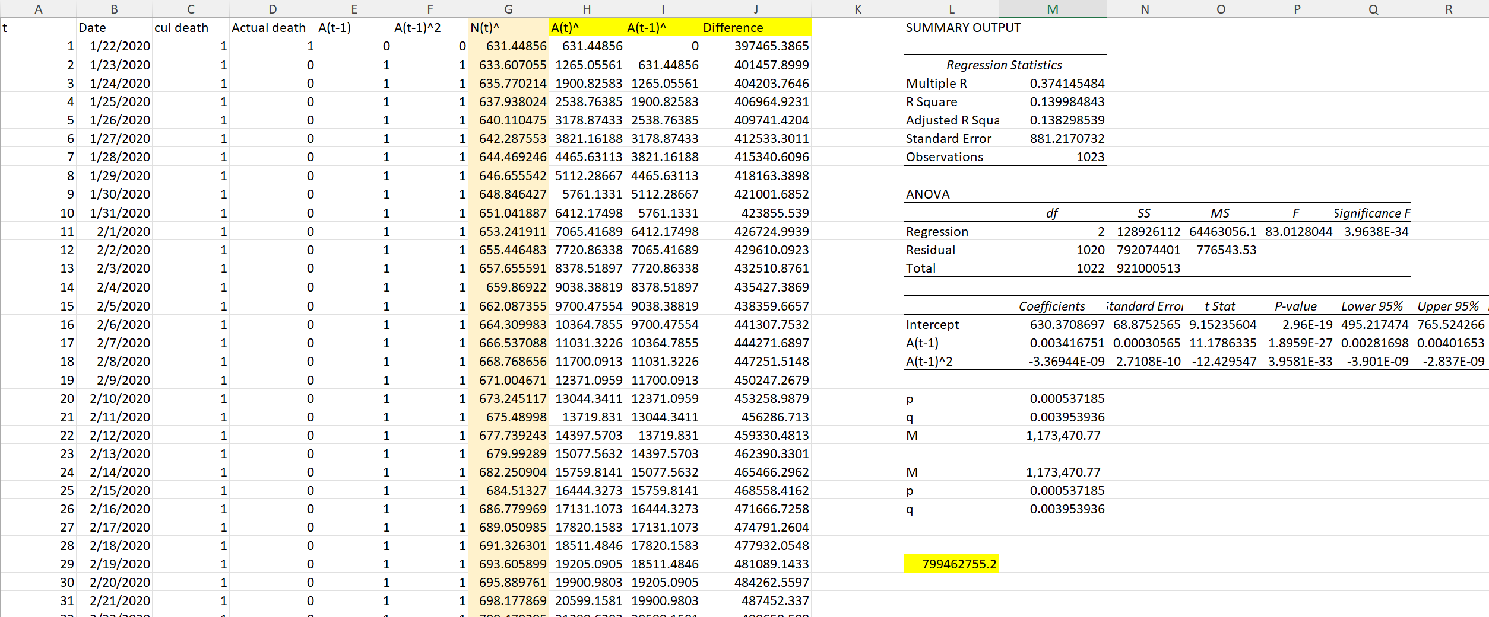
Appendix—Bass Model Daily

Slide 47
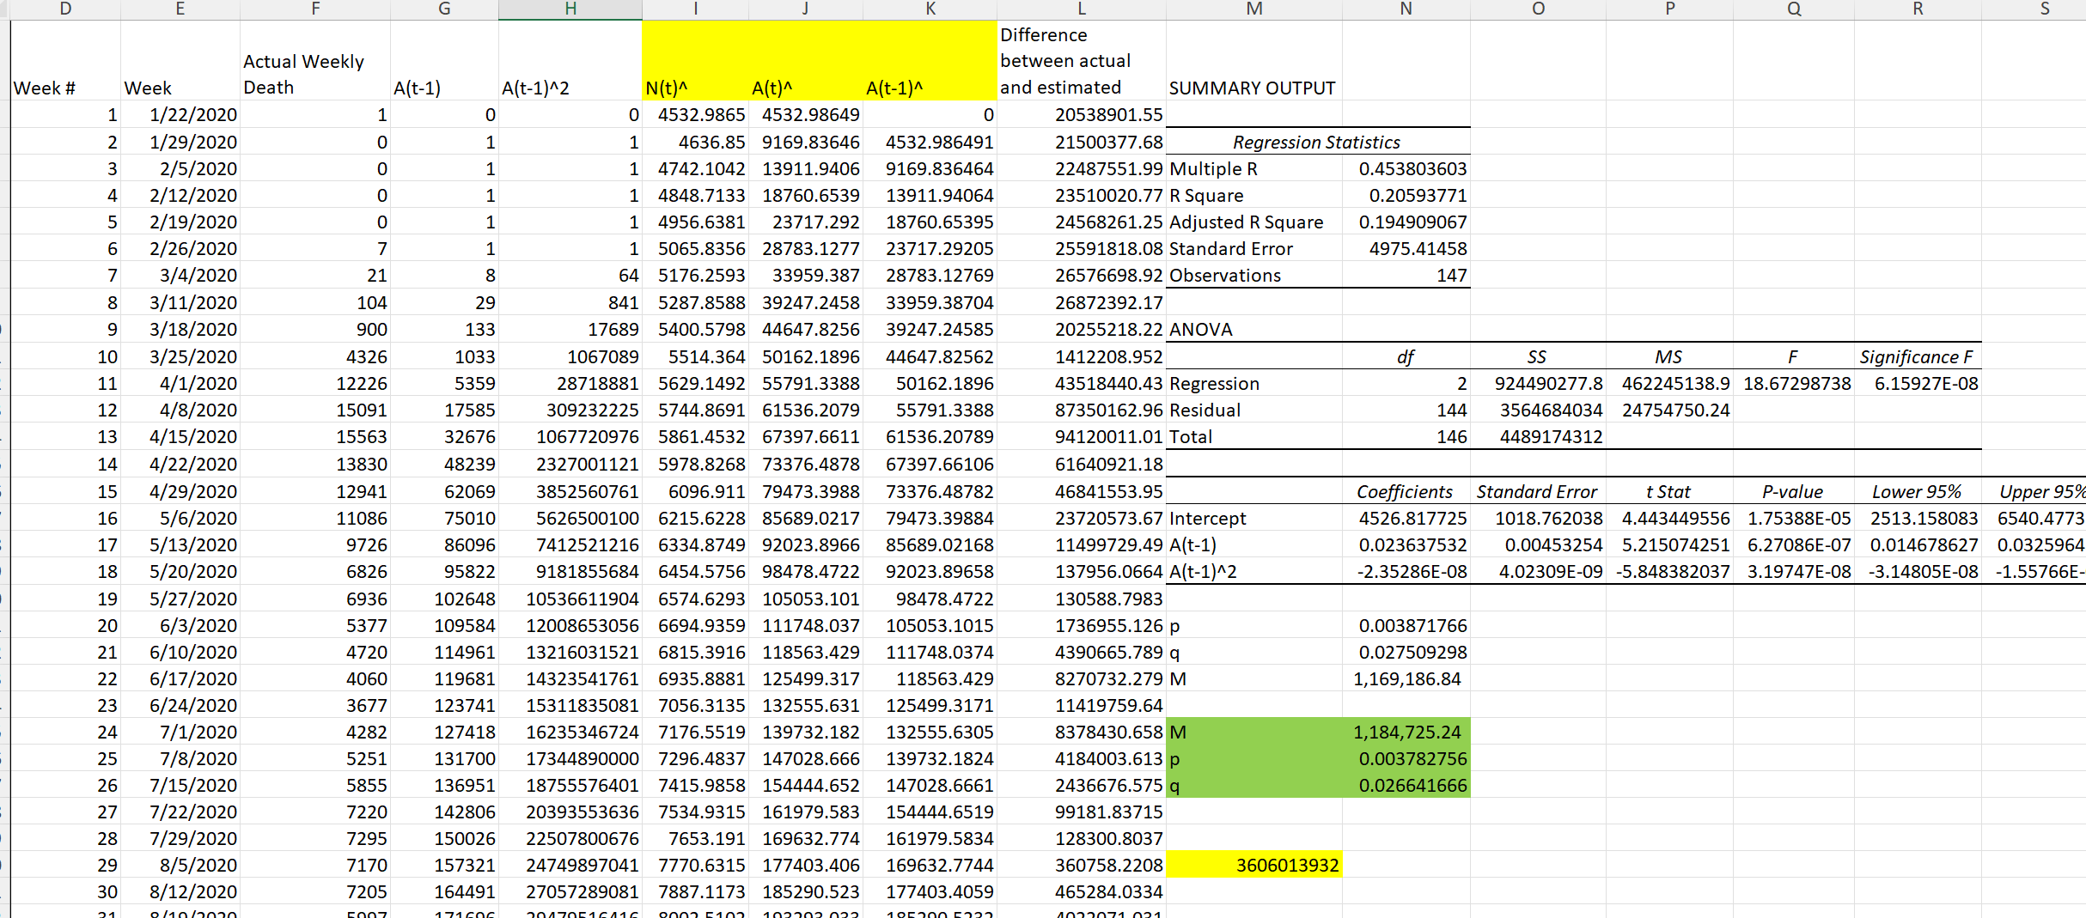
Appendix—Bass Model Weekly

Slide 48
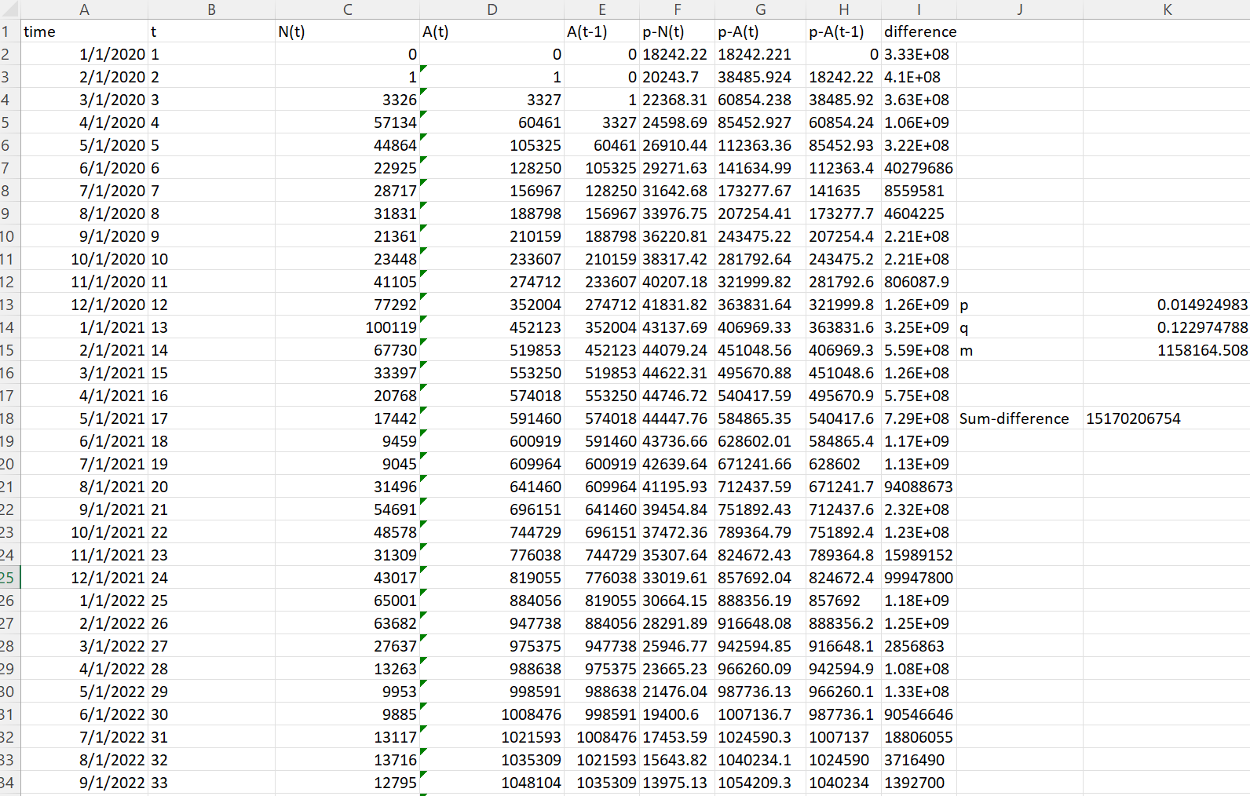
Appendix—Bass Model Monthly

Slide 49
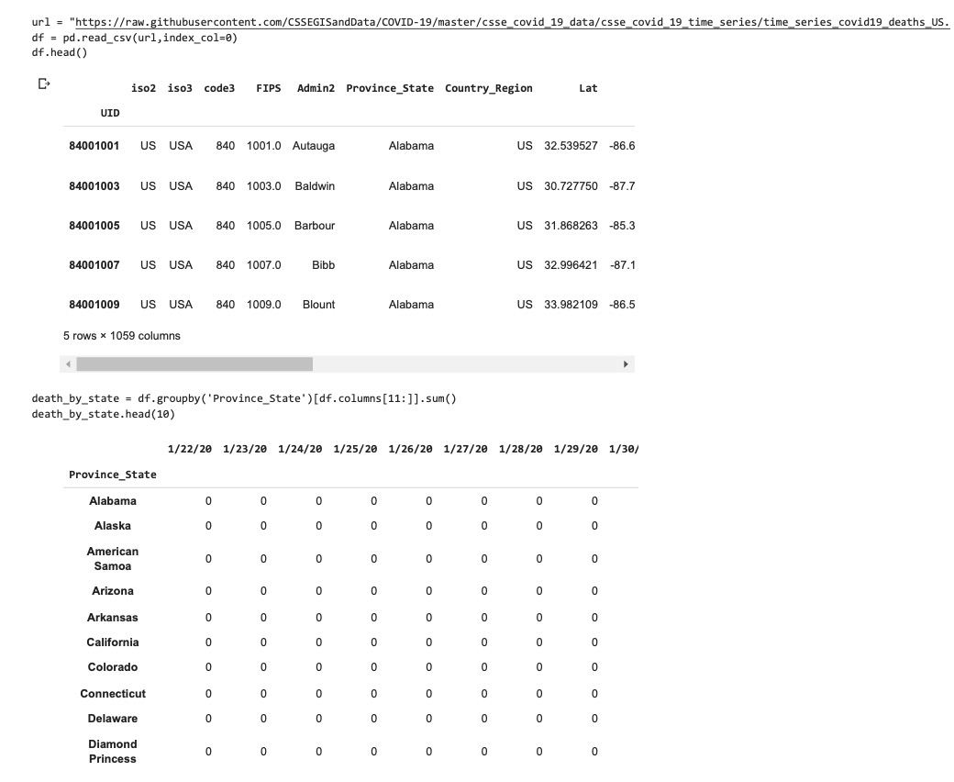
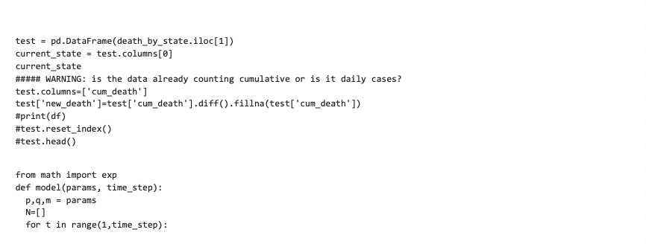
Appendix—Bass Model State Level

Slide 50


Appendix—Bass Model State Level

Slide 51


Appendix—Bass Model State Level

Slide 52





Appendix—Bass Model State Level

Slide 53

Appendix--SIRD

Slide 54


Appendix--SIRD

Slide 55


Appendix--SIRD

Slide 56


Appendix--SIRD

Slide 57

Appendix--GBM

Slide 58

Appendix--GBM

